Slide 1

Opportunities and risks
What’s different about energy
and why does it matter?
Dean Lombard
Alternative Technology Association
27 June 2016

Slide 2

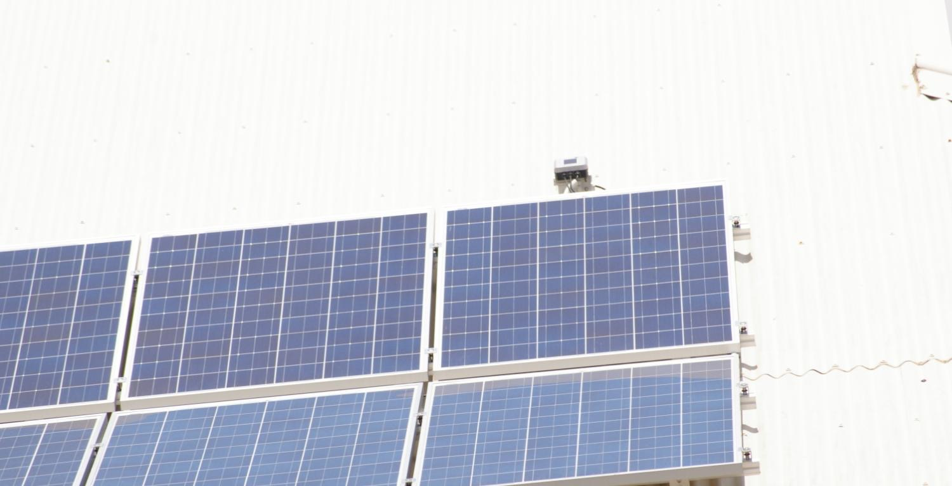
Agenda
What is the ATA?
What’s different about energy?
The suite of consumer protections
What can go wrong?
Putting it all together
Next steps…
D. Parker (via Wikimedia Commons)

Slide 3
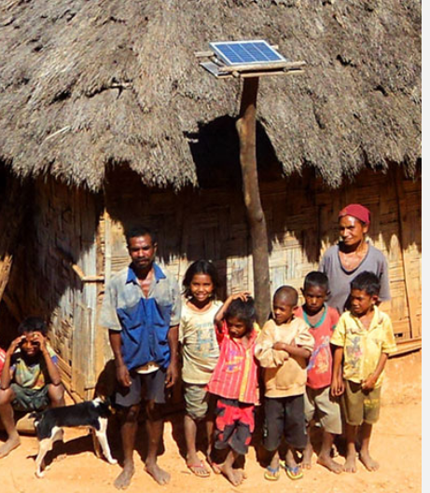
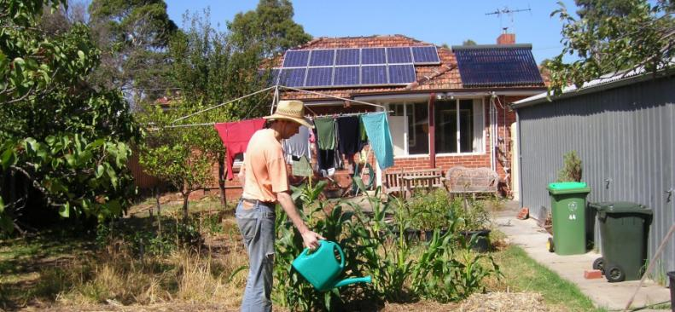
What is the ATA?
Help people to make sustainable choices
Membership base, branches around Australia
Independent, not-for-profit
Policy and research team
Advice and consultancies
International projects
Notes:
Since 1980
Policy & Research: consulting, advice, advocate for consumers when rules are being changed in the NEM.

Slide 4
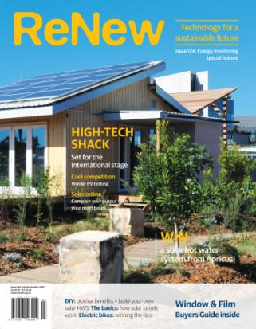


The ATA – Publications
  Published since 1980
  Energy efficiency, renewable energy, electric cars, retrofitting homes, recycling and reusing
  DIY projects
  Published since 2005
  Sustainable homes case studies including house plans and spec sheets
Notes:
Best known for our magazines. Available in newsagents, subscription or membership.

Slide 5
The Innovation Project
Consumers accessing new energy technologies and services should:
  have appropriate, energy-specific protections
  not be impeded by market barriers
The costs and benefits of new energy technologies should be distributed fairly, and without placing other consumers (particularly vulnerable consumers) at a disadvantage
Notes:
To start with, we’ve been looking at consumer protections

Slide 6
What’s different about energy?
It’s essential – but so is food and clothing
You can’t buy it second-hand
You can’t buy it once and then use it for ages
You can’t keep some in the back of your cupboard for emergencies
You can’t mix the expensive stuff with cheap or free stuff to make it go further
You can’t not use it yourself and just give it to your kids to make it go further
It underpins health, hygiene, comfort, nutrition, social engagement, entertainment…
Notes:
You can’t buy it second-hand: It has to be created while you use it
You can’t buy it once and then use it for ages: (except a bit with solar or off-grid) You have to keep on buying it
You can’t keep some in the back of your cupboard for emergencies (except with batteries): Not cost-effectively yet, anyway
You can’t mix the expensive stuff with cheap or free stuff to make it go further: Not unless you get a good solar PV system anyway
You can’t not use it yourself and just give it to your kids to make it go further: Except in a few small ways
It is an enabler of other things more than a thing in itself

Slide 7
The suite of consumer protections
What does regulation provide?
Right to connect
Reliability, quality, safety
Explicit informed consent
Transparent, regulated billing
Concessions and hardship assistance
Dispute resolution
Continuation of supply (RoLR)
Notes:
They will be able to connect to an energy supply – with default products
Their energy supply will meet minimum reliability, quality, and safety standards, and they will be compensated if it doesn’t
They will be given clear information about the service they are purchasing, a cooling-off period for any contract they sign, and in some circumstances (for more novel supply arrangements) a limited right to exit a contract and revert to their previous contract
The basis of all charges is clear and subject to regulatory oversight
They have access to historical billing data
They have access to discounts on their energy costs if they are eligible for concessions
If they come into payment difficulties, they will be given support and flexibility and only disconnected as a last resort and according to a regulated process
They have access to an external dispute resolution service if they are unable to resolve a dispute with their energy supplier
During billing disputes they can stay on supply and not have to pay the disputed amount
If their supplier ceases trading, their supply is uninterrupted

Slide 8

The suite of consumer protections
What does it apply to?
The sale of units of energy to small customers
…with exemptions for non-traditional retailing
Everything else is outside
  generally subject to
  Australian Consumer Law
  Sometimes subject to
  National Credit Code
flickr.com/mukluk/
Notes:
A retailer authorisation will likely be required where the seller meets the following criteria:
the seller is the primary source of energy to the premises of a small customer for a particular fuel
the seller is selling energy to premises across multiple sites
the seller is registered in the wholesale market for the particular fuel source, and is the financially responsible retailer for the particular premises.
We may issue retail exemptions where, for example, the energy seller is:
providing an “add-on” or supplementary service to a customer who also buys energy from an authorised retailer
providing a bundled contract for a service that includes the sale of energy, but where the sale of energy is a small or insignificant component of that contract.^{[1]}

Slide 9
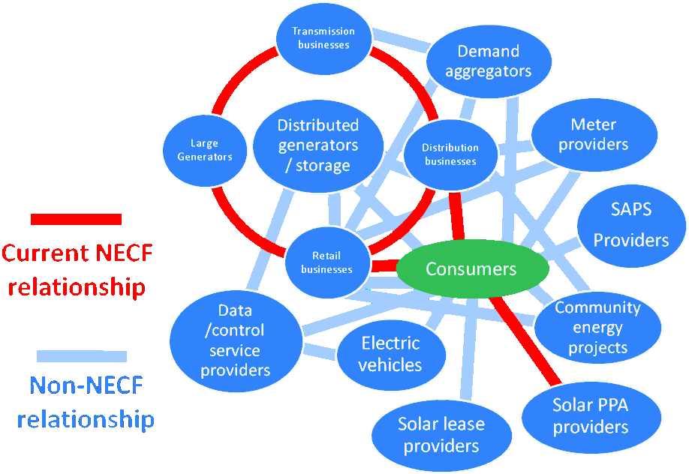
The suite of consumer protections
Notes:
No cost solar is the best example for the arbitrariness of it. To the consumer, they’re very similar. But a PPA is under the NECF (though exempt) while a lease is completely outside it.
THESE THINGS USED TO BE NICHE PRODUCTS FOR RELATIVELY WEALTHY AND INFOMRED CONSUMERS.
BUT WE ARE HEADING FOR A WORLD WHERE ANYBODY COULD BUY OR LEASE A DWELLING AND FIND THESE SYSTEMS OF SERVICES INSTALLED

Slide 10
What can go wrong?
Person gets PPA that’s bigger then they need
  Ends up selling electricity for less than they buy it
Person with solar lease gets into financial hardship
  What happens next?
Person gets off-grid system and then their usage increases significantly
  What are their options?
Person buys house with off-grid system
  Can they get back on the grid?
Off-grid system breaks down within warranty period but liable business no longer exists
  What now?
Battery management service has timeclock error
  Battery charged during peak tariff

Slide 11
Putting it all together…
Universal consumer protections
Dispute resolution
  Internal and external
Clear and transparent product/service information
  Marketing rules
  Explicit informed consent
Concessions
  Tailored, delivered as a rebate or discount as appropriate
Right to reconnect
  At a reasonable cost
Notes:
INFORMATION includes facilitating customer knowing if they will be better off, and if the product is appropriate for their needs, and understanding their needs might change

Slide 12
Putting it all together…
Product class-specific protections
Safety and reliability
Basic quality standards
Accuracy of measuring and timing equipment
Responding to financial hardship
Provision of usage information
Treatment of life support customers
Provision for business failure
  Proportional to
  the essentiality of energy supply and
  the impact of financial hardship on the customer
Notes:
QUALITY: supply and installation
FAILURE: continuity of supply
ALL UP IT WILL PROBABLY REQUIRE SOME FORM OF ACCREDITATION AND A FUNDAMENTAL REVIEW OF EXEMPTIONS AND LICENSING FRAMEWORKS
Complications of the crazy parochial NEM

Slide 13
Next steps…
Getting more specific
  Which requirements for which products?
Looking at the licensing/authorisation and exemptions framework
Looking further at the barriers – including those facing low-income and vulnerable consumers
The fine line between appropriate regulation and burdensome requirements
A technology- and mode-agnostic market
  How do we make sure everyone has access to an essential supply of energy?
Notes:
Discussion paper
ALL UP IT WILL PROBABLY REQUIRE SOME FORM OF ACCREDITATION AND A FUNDAMENTAL REVIEW OF EXEMPTIONS AND LICENSING FRAMEWORKS
Complications of the crazy parochial NEM
INNOVATION is really important in this space and must be enabled; especially because large businesses can wipe out the little guys and form a comfortable oligopoly.
The world is changing. A transition to a more disaggregated and two-way NEM requires us to go back to first principles

Slide 14
Questions or comments?
Dean Lombard
Senior Energy Analyst
dean@ata.org.au

