Slide 1
LIFE AFTER FEED-IN TARIFFS
Mark Byrne, Total Environment Centre
Tom Nockolds, Community Power Agency

Slide 2
Project partners
This project was funded by Energy Consumers Australia as part of its grants process for consumer advocacy projects and research projects for the benefit of consumers of electricity and natural gas. The views expressed in this document do not necessarily reflect the views of Energy Consumers Australia.

Slide 3
Premium feed-in tariffs
NSW – Solar Bonus Scheme:
Paying a premium price for solar electricity exported to the grid
Stimulating investment in solar industry
Cost have come down
Designed to operate for a limited time

Slide 4
Who is affected?
South Australia
Since 2011
62,785 customers
Until 30 Sep 2016
New South Wales
Since 2010
146,000 customers
Until 31 Dec 2016
Victoria
Since 2011
67,160 customers
Until 31 Dec 2016

Slide 5
Bill shock

Slide 6
Bill shock
The average loss of income for someone with a 2kW system currently on the 60c SBS is ~$1600 pa
Your “behind the meter” solar will still be worth about $450 pa
Increasing your usage from 50% to 75% will earn you about another $200 pa
Notes:
2Kw x 4 h/day x 365 days x 60c = $1750
2Kw x 4 h/day x 365 days x 6c = $175
Difference = about $1600

Slide 7
Financial motivation
“How to minimise the financial impact of the end of the Solar Bonus Scheme”

Slide 8

Tech report
Commissioned by Total Environment Centre
Prepared by Alternative Technology Association
Describes the financial impact on customers of the end of premium feed-in-tariffs
Outlines opportunities such as metering, retail strategies, batteries, etc.

Slide 9
Key terms
Premium feed-in tariff - 60c/kWh or 20c/kWh
Retail energy cost ~27c/kWh
Standing charges ~$1/day
Solar export price - 0-10c/kWh
Payback period

Slide 10
five step plan

Slide 11
Before you start
You aren’t legally required to do anything – but you’ll be worse off, and decisions may be made for you
It’s good to know who your retailer is, what tariff you’re on and what appliances use the most energy around your home
To lower your electricity bills there’s a host of other energy conservation and efficiency measures you could consider

Slide 12
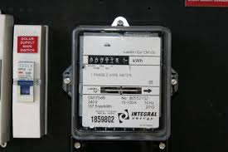
Step 1: Get the right metering
NSW Solar Bonus Scheme was based on a ‘gross’ feed-in tariff

Slide 13
Step 1: Get the right metering
If your feed in tariff is higher than the price you pay for electricity, gross metering is better

Slide 14
Step 1: Get the right metering
If your feed in tariff is lower than the price you pay for electricity, net metering is best

Slide 15
Step 1: Get the right metering
Options
  Do nothing
  Network may read your gross meter as a net meter (~$150?)
  Get a new interval meter from your network (up to $600?)
  Get a new “free” smart meter from your retailer

Slide 16
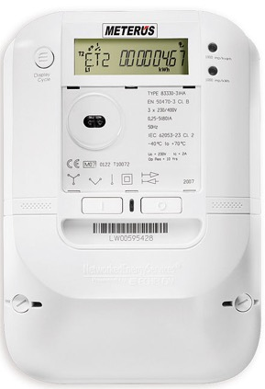
Step 1: Get the right metering
What is a smart meter?
2 way comms – ie, sends data back to network and retailer daily
Makes some functions easier and cheaper
Required from 2018 for new home + replacements
Radiation concerns

Slide 17
What do smart meters do?
Turn electricity supply on and off remotely
Meter read — scheduled and on demand
Meter installation enquiry — remotely obtaining energy information, meter status, and usage data
Meter reconfiguration – remotely enable access to new tariffs and new arrangements, such as solar connections and demand tariffs

Slide 18
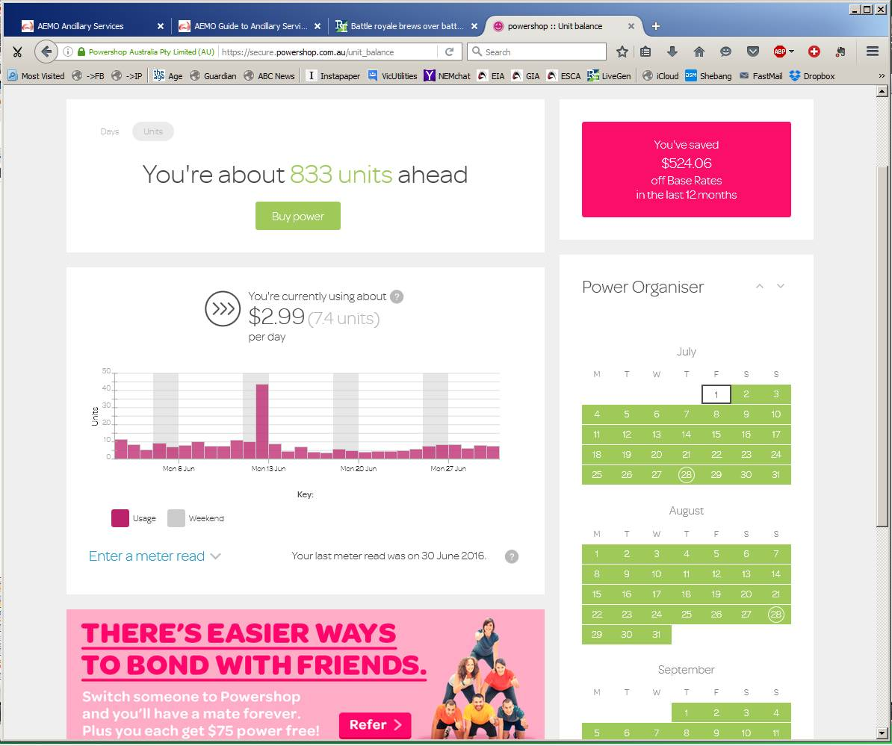
Smart meter data

Slide 19
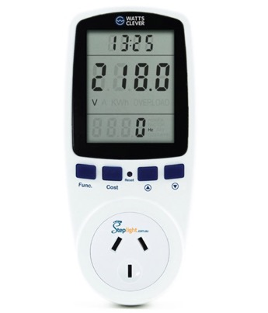
Passive energy monitors and in home displays
Notes:
L: simple 1 appliance monitor
M & R: full IHDs

Slide 20
Energy management systems & “push controls”
“Internet of things”
Control appliances remotely
EMSs automatically choose best place to put your solar energy
Notes:
L: AGL Solar Command (similar to Solar Analytics)
R: Reposit Power’s GridCredits

Slide 21
Selling your energy
Notes:
L: AGL Solar Command (similar to Solar Analytics)
R: Reposit Power’s GridCredits

Slide 22
STEP 1: WHAT TO DO?
Has your retailer already contacted you?
  If so, get cracking!
  Opt-in or opt-out?
  Carefully evaluate their offer, eg re new terms & conditions
Make sure your ‘gross’ metering runs until 31 Dec 2016
Get enrgy data from the retailer’s web portal
Consider an energy monitor

Slide 23
Step 2: Use more of your solar electricity
The average household exports more than 50% of its solar energy to the grid, but…
Your solar is worth more to you (~27c) than to your retailer (0-10c) so…
Maximise the use of your solar rather than export it!

Slide 24
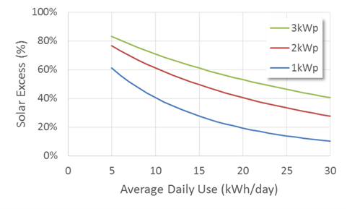
How much am I “wasting”?
Notes:
Image courtesy Dr Martin Gill using Ausgrid data

Slide 25
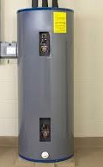
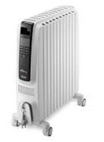
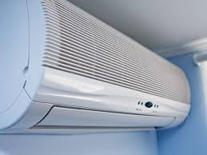
Step 2: Use more of your solar electricity
What are the two biggest energy uses in a typical Sydney home?
Space heating and cooling
Hot water

Slide 26
Step 2: Use more of your solar electricity
Hot water heating using solar electricity
  Traditional electric storage hot water system
  Heat pump (similar to a reverse-cycle air conditioner)
Requires
  Net metering
  Water heater not on off-peak circuit
  Operates during the day (install a timer or switch)
  May require rewiring

Slide 27
“A large 400L tank will store about 19kWh of usable energy, which is more than double the nominal capacity of Tesla's new daily-cycle 7kWh Powerwall unit.”
CHOICE
Considerations
How big is your solar system and your hot water tank?
How much do you get for exported solar and pay to heat water?
Do you need an electrician to do this?
Notes:
Quote from Choice article

Slide 28
Step 2: Use more of your solar electricity
Heating or cooling using solar electricity
  Reverse cycle air conditioning
  Heat pump hydronic system
Requires
  Net metering
  A well insulated house
  Possibly remote control of appliances

Slide 29
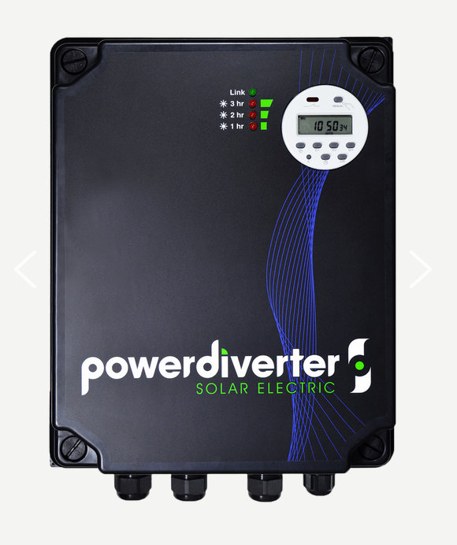
Power diverters

Slide 30
NABERS Energy Explorer

Slide 31
STEP 2: WHAT TO DO?
Where possible use appliances when the sun is shining
Move towards electric hot water and heating/cooling
Install timers on your hot water system and other appliances
Pre-heat or pre-cool your house (if you’ve got good insulation)

Slide 32
STEP 3: Make a plan to get off gas
Why have 3 sources of energy?
Using electricity to power your two main appliances (hot water and heating/cooling) makes more sense
An all electric home can save thousands of dollars each year
Induction cooking is more efficient than cooking with gas

Slide 33
STEP 3: WHAT TO DO?
No urgency, but gas appliances, when they fail, may need replacing immediately, so make a plan to get off gas
  Hot water system
  Cooking
  Heating

Slide 34
Step 4: Get the best electricity deal
Shop around, taking into account
  Your solar export price
  Daily supply charge
  Consumption (c/kWh) charges
  Pay on time discount
Know the tariff types available to you
Avoid getting locked into a bad deal for a long time
Notes:
Does anyone know what tariff
Flat, declining, time of use)

Slide 35
Solar export prices
IPART’s “benchmark rate” = 5.5-7.2c/kWh
Retailers currently offering 0c-10c/kWh
Notes:
Does anyone know what tariff
Flat, declining, time of use)

Slide 36
Tariff types
Flat
Inclining or declining block
Time of use
  Better for “at homes”, worse for working families
Demand
  Likely to be more common in future
New
  Fixed for a year or “All you can eat”
  Wholesale plus flat monthly fee
Notes:
Does anyone know what tariff
Flat, declining, time of use)

Slide 37
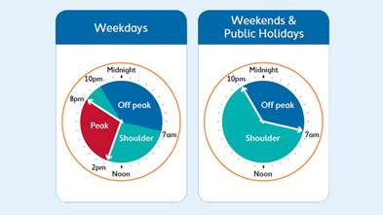
Ausgrid’s time of use tariffs

Slide 38
Step 4: Get the best electricity deal
For green electricity, consider GreenPower
Check out the Green Electricity Guide

Slide 39
STEP 4: WHAT TO DO?
Calculate your likely total annual bill with your current retailer after the SBS ends
Consider whether you are on the best tariff type
Use a comparison site like Energy Made Easy to shop around
Read the terms and conditions closely
Notes:
Flat tariffs best for working families, ToU or demand best for stay-at-homes (because they use more when energy is cheap)

Slide 40
Step 5: Consider more solar or a small battery
More solar might makes sense if you have a west-facing roof
May require wholly separate system

Slide 41
Battery economics
Retrofitting batteries is not currently cost effective
Smaller batteries may become economic before 2020
Going offgrid is unlikely to be economic for decades

Slide 43
Why get a battery?
Save money by reducing peak consumption
Make money by selling power back to the grid
Have backup in case of blackouts
Be energy independent
Store renewable energy

Slide 44
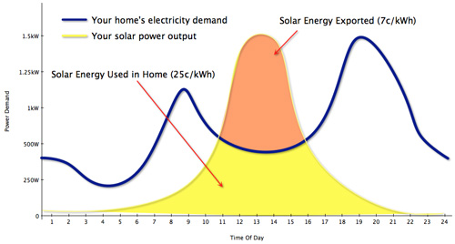
The logic of peak shaving
Notes:
Solar Choice

Slide 45
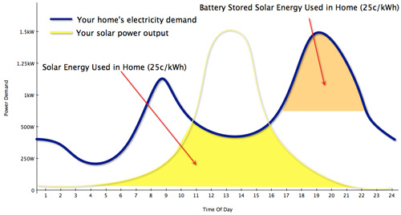
The logic of peak shaving

Slide 46
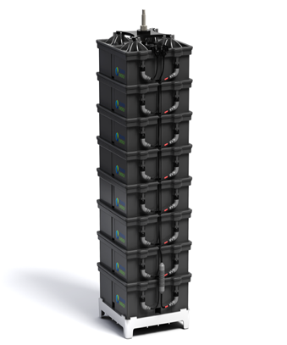
Considerations
Peak shaving, backup or offgrid capability
Matching output to solar + consumption
Single or modular
Power or energy
Warranty – eg cycles
Tech specs
Compatibility with hybrid inverters
Environmental (lifecycle) concerns

Slide 47
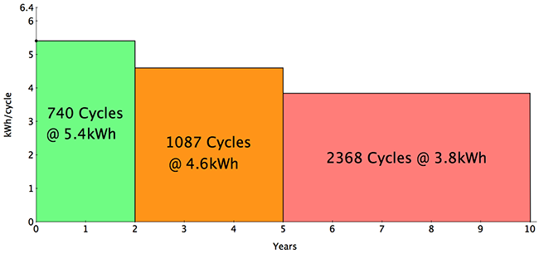
Tesla warranty

Slide 48
Offgrid economics
SCENARIO 1 – TYPICAL SYDNEY HOUSEHOLD (6500kWh pa)
Average daily consumption = 20kWh
5 day wet/cloudy spell = 100kWh
Battery cost @ ~$1000/kWh = $100,000
Average bill = $2000 pa
Oversimplified payback period = 50 years
Notes:
Simple payback period doesn’t include NPV, maintenance/replacement costs, etc

Slide 49
Offgrid economics
SCENARIO 2 – SMALL EFFICIENT RURAL HOUSEHOLD (1500kWh pa)
Average daily consumption =5kWh
2 day wet/cloudy spell* = 10kWh
Battery cost @ ~$1000/kWh = $10,000
Average bill = $1000 pa
Oversimplified payback period = 10 years
* How much do you like candlelight and melted icecream?
Notes:
Simple payback period doesn’t include NPV, maintenance/replacement costs, rising retail tariffs, ToU tariffs, etc

Slide 50
STEP 5: WHAT TO DO?
Prepare for batteries by completing steps 1-4
Do your sums: for love or money?
Don’t upgrade your existing inverter until you’re ready to consider batteries
Keep your eye on prices
Talk to an established local solar specialist

Slide 51
THE BOTTOM LINE
OPTION 1: HERE AND NOW or MINIMALIST
  Follow steps 1 and 4
OPTION 2: FUTURE NO-SHOCK
  Generate most of own power
  Bills under $1000
  One meter
  One fuel source
Then…
  Follow all 5 steps
  Don’t forget energy efficiency

Slide 52
Getting help
This project: www.solarcitizens.org.au/life_after_fits
Basic info:www.resourcesandenergy.nsw.gov.au/energy-consumers/solar/solar-bonus-scheme
Retailer comparison: www.energymadeeasy.gov.au
Energy Storage Council: http://energystorage.org.au/wp-content/uploads/2016/05/BATTERY_GUIDE_WEB.pdf
Home energy options: http://home.nabers.com.au
Complaints: www.ewon.com.au

Slide 53
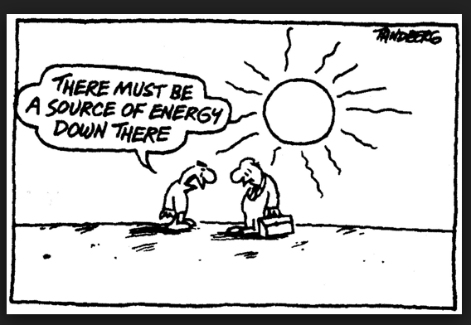
Thank you

