Slide 1
Mark Byrne
Energy Market Advocate

Slide 2
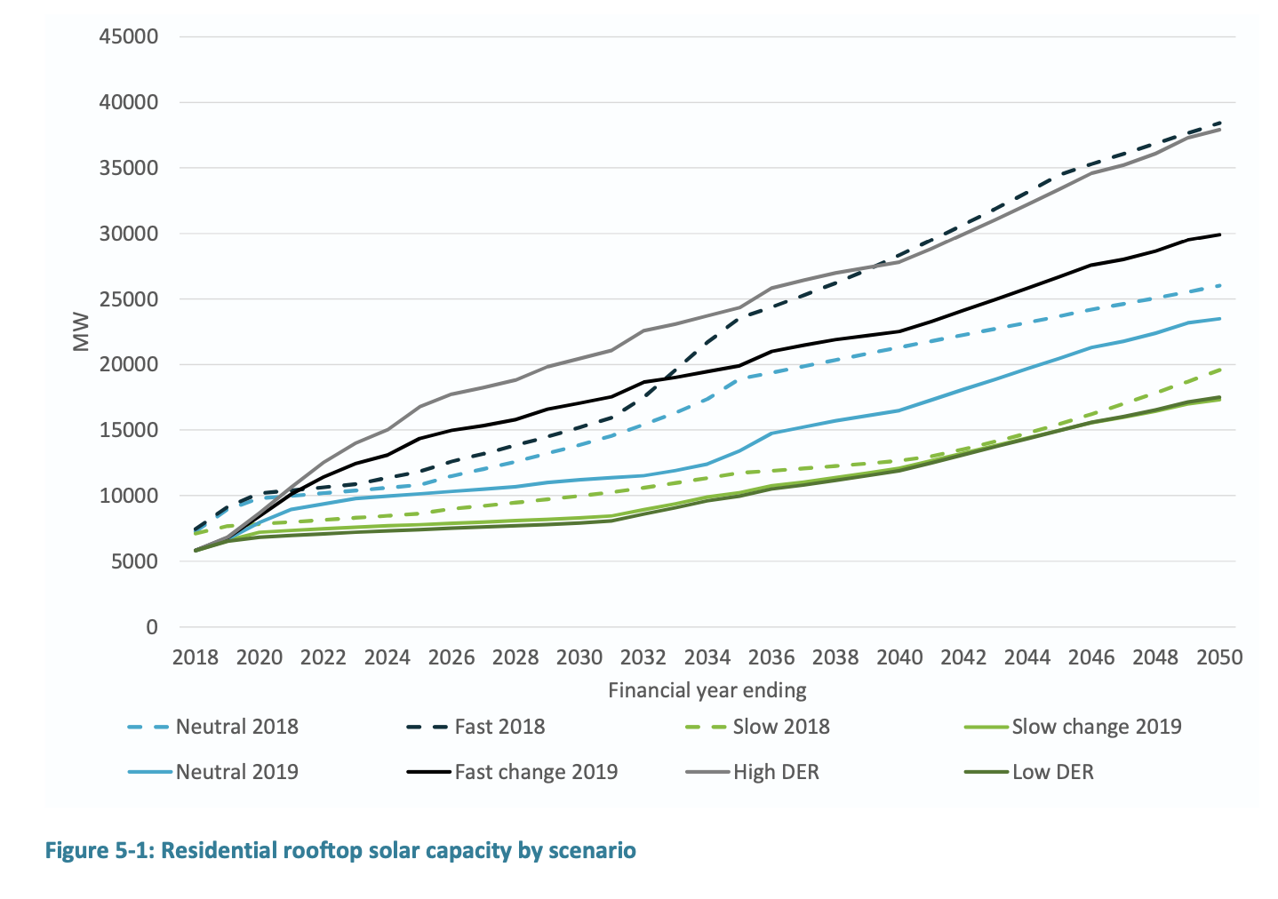
“By 2050, it is estimated that... customer owned generators will supply 30-50% of Australia’s electricity needs.” (2016 NTR)

Slide 3
How good are DER?
7% total NEM consumption & up to 50% operational demand (SA) met by rooftop PV
<$360 million in DER-related network expenditure by 2025
<$1 billion (?) by 2030 for <15% total NEM consumption
“The High DER scenario shows the potential for even greater use of DER to lower the total costs to supply, with the NPV of wholesale resource costs reduced by nearly $4 billion, compared to the Neutral case.”(AEMO 2018 ISP)
Versus $8-27 billion on new transmission and interconnection by 2040
Notes:
“Rooftop solar installed by Australian homes and businesses in on track to generate between 31-50TWh of power across the National Electricity Market by 2040, according to the Australian Energy Market Operator, and supply up to 22 per cent national demand.” RE 2018

Slide 4
Problems and solutions
Equity impacts
Recovering subsidies via taxes instead of bills
Shift to more cost-reflective tariffs
Tech challenges
Voltage
Smart inverters
Lowering network nominal voltage
Transformer tap changes
Dynamic DER management
Capacity (thermal constraints)
Tariffs to fill solar trough
Inefficient investment & operation of networks
Solar export limited during midday trough
VPP batteries export limited during high wholesale price periods
Augex for new developments not incentivised

Slide 5
What regulatory reforms are needed to ensure the most efficient, equitable and sustainable investment and operation of DER in the long-term interests of all?

Slide 6
Models to burn
Export pricing
Networks to charge and/or reward for DER exports depending on network impacts
Flexible access/connections
Upfront charge for future network costs at time of connection—likely in return for firm access for exports
Local use of system pricing
DUOS reflects network utilised between generation & load
Resilience incentive
Benefits recognised of nested/islandable local grids during upstream blackouts
Two sided network pricing
Users pay for combined imports & exports to recover all network costs
Notes:
Combos possible

Slide 7
Potential applications
Solar trough—to efficiently utilise or expand limited solar hosting capacity
Community batteries—to transport energy 2 ways without incurring full network costs
VPPs—to minimise network impacts of aggregated battery charging +/or discharging
P2P trading—to allow through meter without compromising market metering, billing & settlements
Other new energy services markets—eg demand response, network support or ancillary services
HILP events—to incentivise resilient local networks
Notes:
Want to capture as many as possible, and leave room for unknowns

Slide 8
Options
Compulsory or optional for networks to adopt?
Locational and temporal or smeared?
What is the best way for networks to recover these costs—connection agreements (fixed), energy charges (kWh) or capacity charges (kW)?
What should DER owners expect in return—firm access?
Notes:
Second order considerations

Slide 9
Other considerations
Should networks be able to take into account other market benefits when charging or rewarding for DER transactions?
Merit order effect
Reduced transmission investment
Lower line losses
How would this mechanism interact with a DSO model?
To what extent does this reform require an equivalent reform of transmission pricing?
Notes:
Third order considerations

Slide 10
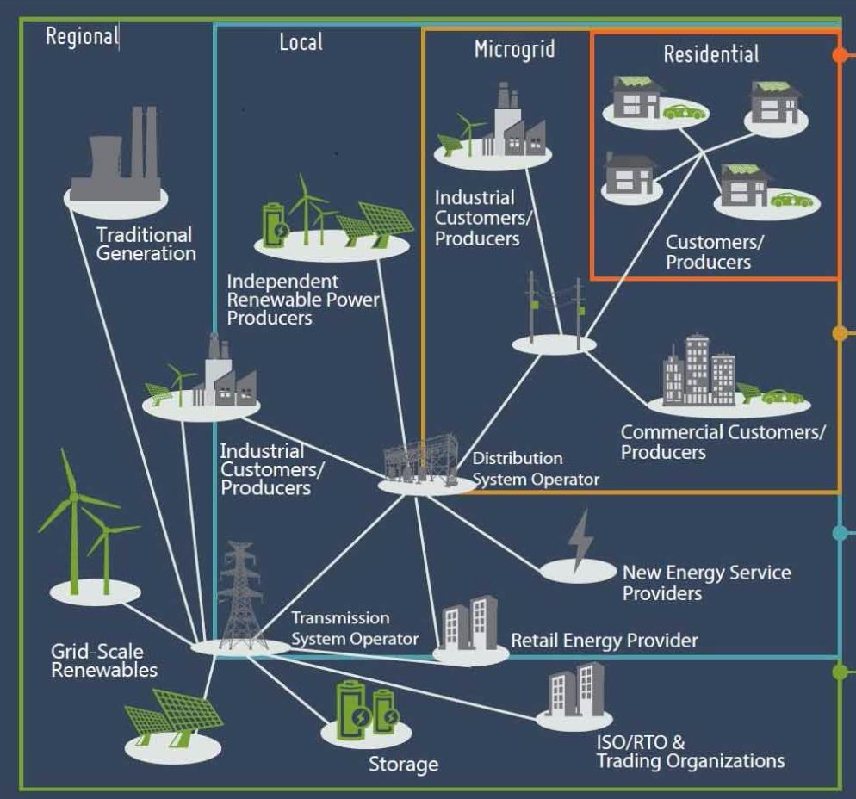
ENERFR on DER & resilience
“Under a nested arrangement, which is a form of decentralisation, resilience is provided in layers. The outer layer might be the equivalent of a NEM region. Depending on the resources available, services and supply might be available at local (perhaps zone substation), microgrid or even individual customer level, at least for a period of time. The deeper the resource penetration, the greater the potential for local network resilience…“

Slide 11
Export pricing pros and cons
Pros
DER owners pay for new network costs imposed.
DER owners rewarded for network benefits.
Compatible with dynamic DER management.
Cons
Either inaccurate/inefficient or highly complex.
Doesn’t deal with other DER access and pricing issues.

Slide 12
The ESC’s view
If a network value FiT was calculated with sufficient granularity to reflect the underlying network value it would be disproportionately complex and costly to implement. If it were made simple enough to implement, it would be inadequately reflective of value and could lead to payments to distributed generators who were not providing benefits while, at the same time, not sufficiently rewarding those who were.

