Slide 1
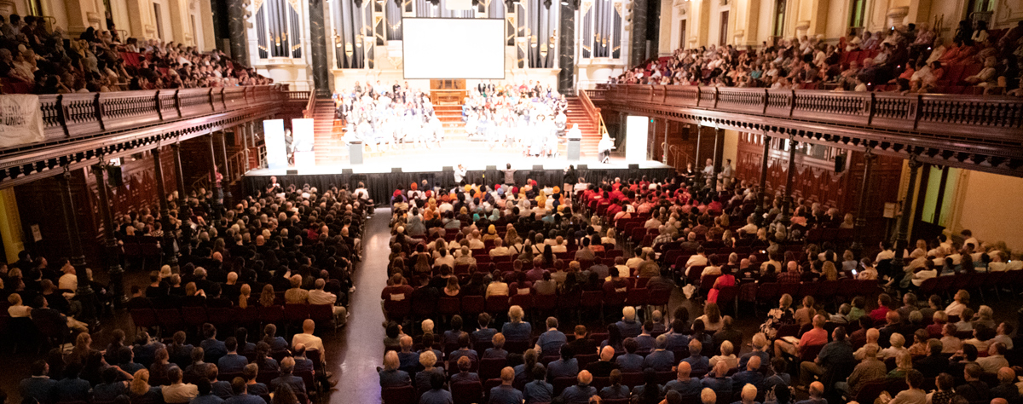
VOICES FOR POWER
Organising migrant and religious communities to find solutions for AFFORDABLE & RENEWABLE ENERGY!
18th November 2019 | EWON Office
Michal Levy & VFP Leaders Delegation

Slide 2
THE ANALYSIS OF THE PROBLEM

Slide 3
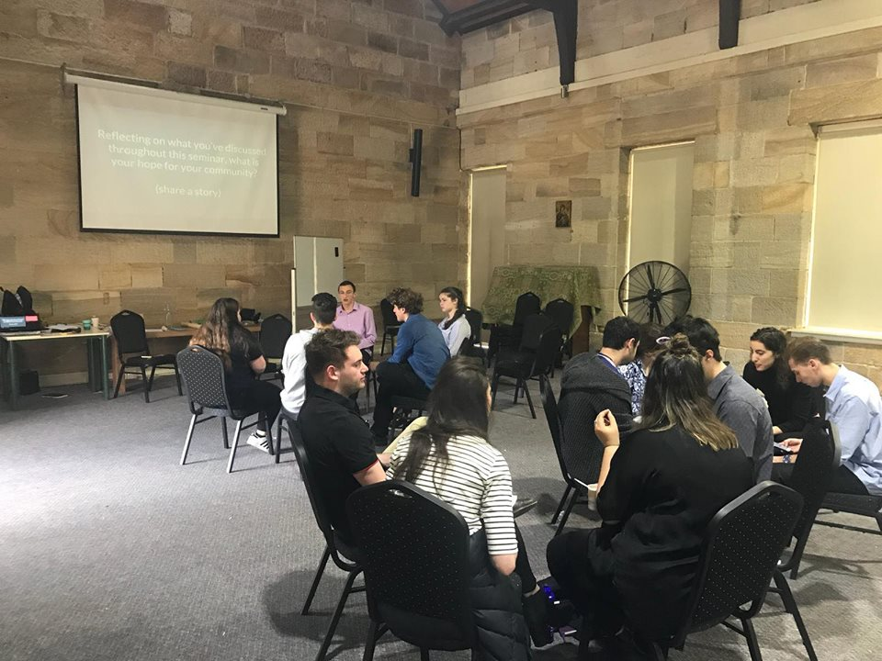
ENERGY IS A BASIC NEED
COST OF LIVING PRESSURES ON US AND OUR FAMILIES
OUR VOICES AREN’T BEING HEARD OR ADVOCATED FOR

Slide 4
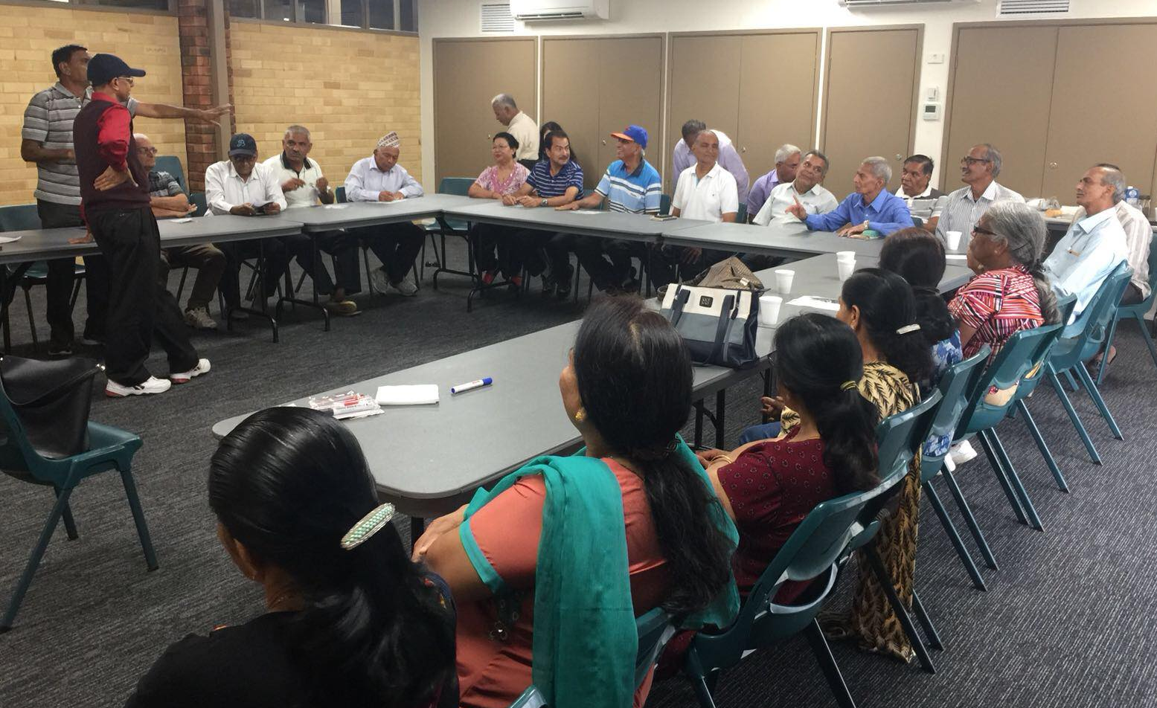
STRUCTURAL BARRIERS TO MEANINGFULLY NAVIGATE THE ENERGY MARKET LEAVE ISSUES SILENTLY SHOULDERED

Slide 5
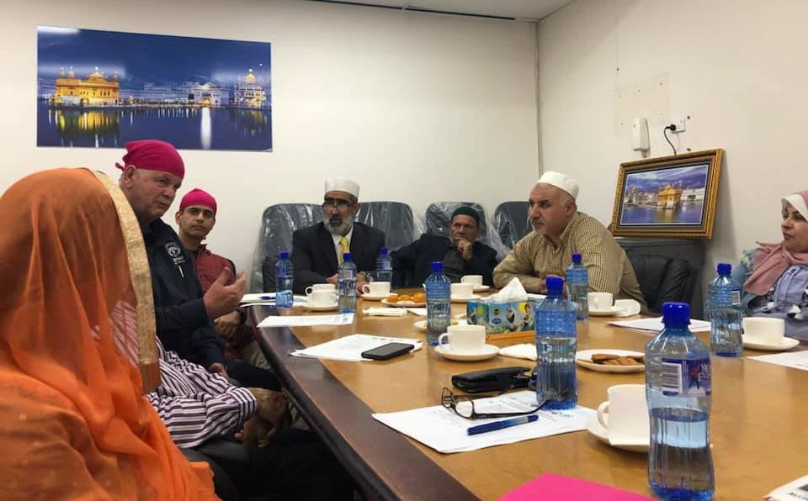
AS CLEAN ENERGY TECHNOLOGY COMES INTO THE MARKET AND AS THE ENERGY TRANSITION HAPPENS, WITHOUT BUILDING OUR POWER - OUR COMMUNITIES WILL BE LEFT BEHIND

Slide 6
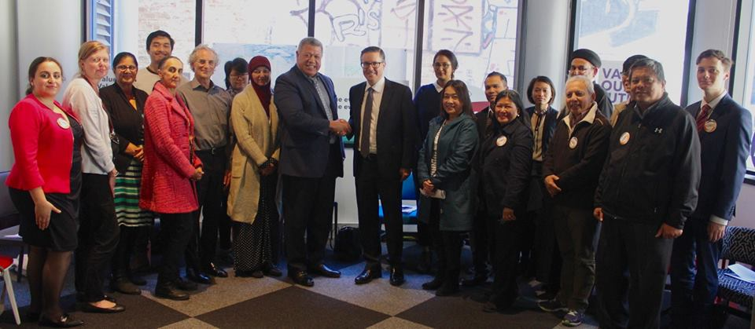
OUR AIM TO INFLUENCE:
Notes:
Funders: Anchor funding:

Slide 7
THE ANALYSIS OF THE PROBLEM
THE VOICES OF C.A.L.D COMMUNITIES ARE NOT BEING HEARD;
OUR ISSUES ARE NOT BEING UNDERSTOOD;
OUR IDEAS AND SOLUTIONS ARE NOT TAKEN INTO ACCOUNT BY DECISION MAKERS

Slide 8
OUR APPROACH: RELATIONAL ORGANISING

Slide 9
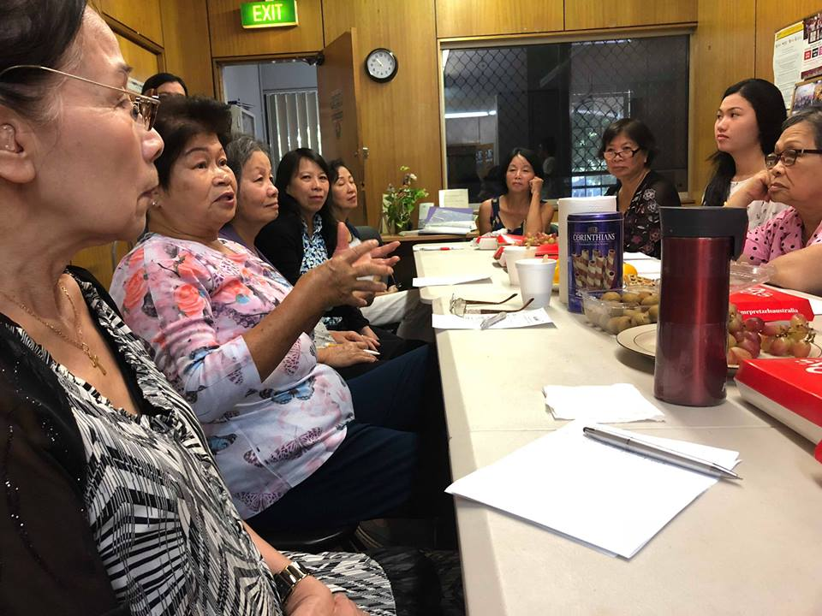
LISTENING
LISTENING: VOICES FOR POWER COMMUNITY TABLE TALKS

Slide 10
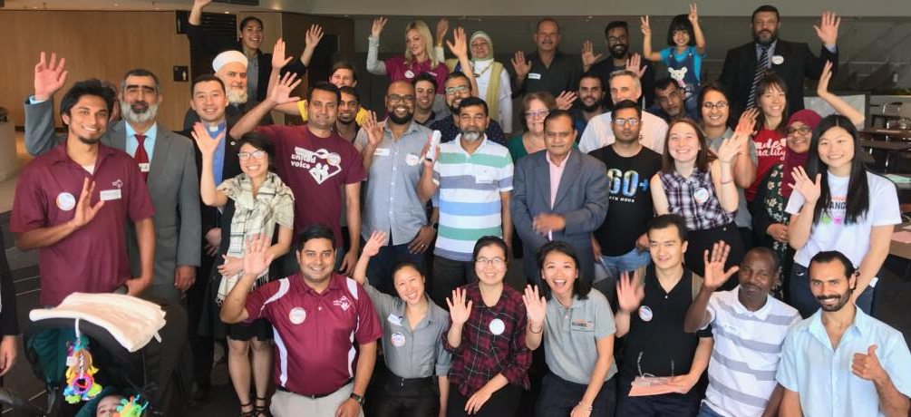
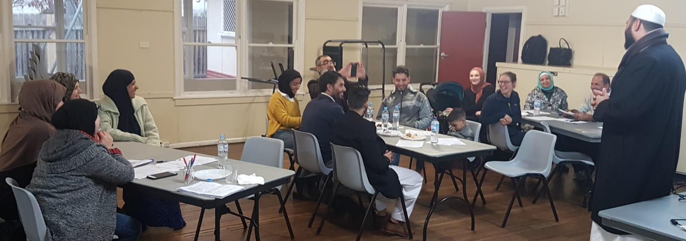
Table Talk
LISTENING: VOICES FOR POWER COMMUNITY TABLE TALKS

Slide 11
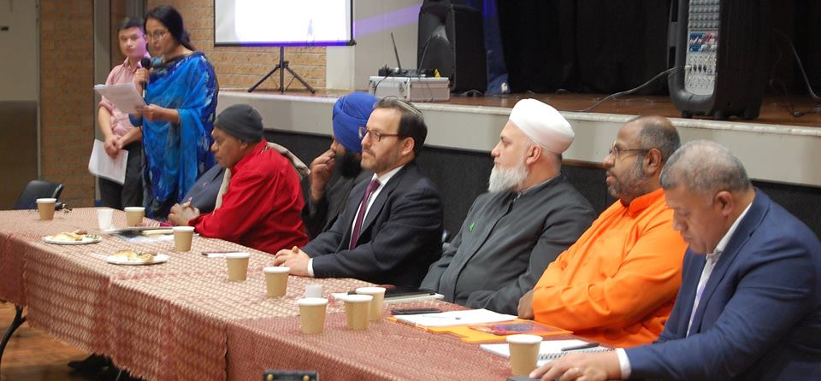
LISTENING: VOICES FOR POWER INTERFAITH TABLE TALK

Slide 12
LISTENING: VOICES FOR POWER COMMUNITY TABLE TALKS

Slide 13
LISTENING: VOICES FOR POWER COMMUNITY TABLE TALKS

Slide 14
LISTENING: VOICES FOR POWER COMMUNITY TABLE TALKS

Slide 15
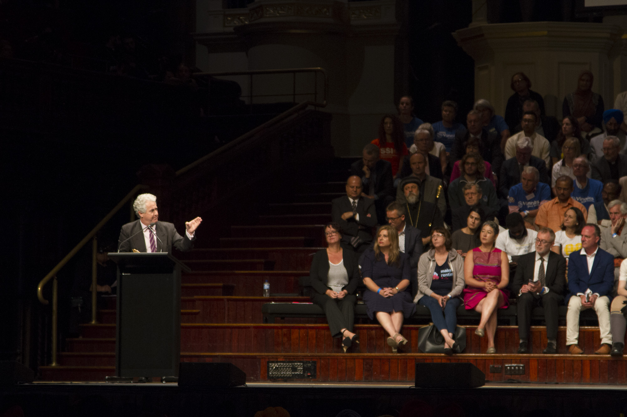
NON-PARTISAN POLITICAL ACTION FOR POLIY CHANGE
Pinning State Opposition Minster for Energy Adam Searle – March 2019

Slide 16
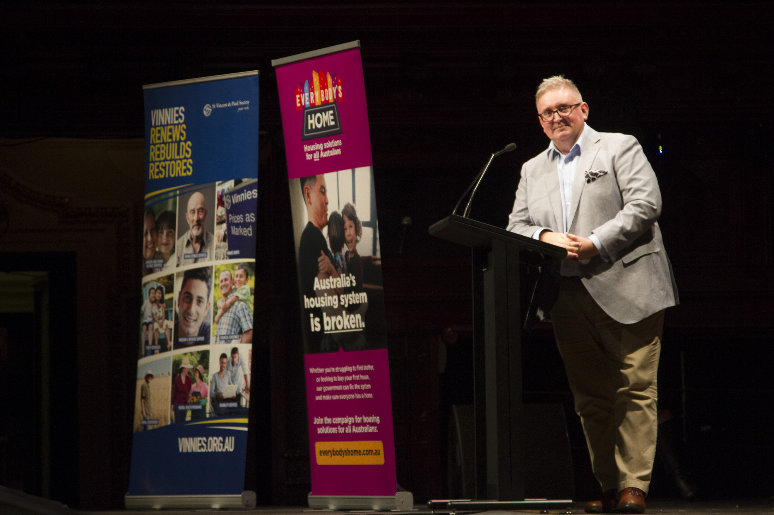
Pinning State Minster for Energy Don Harwin – March 2019

Slide 17
BUILDING LEADERSHIP IN COMMUNITIES TO BUILD ENERGY CONFIDENCE

Slide 18
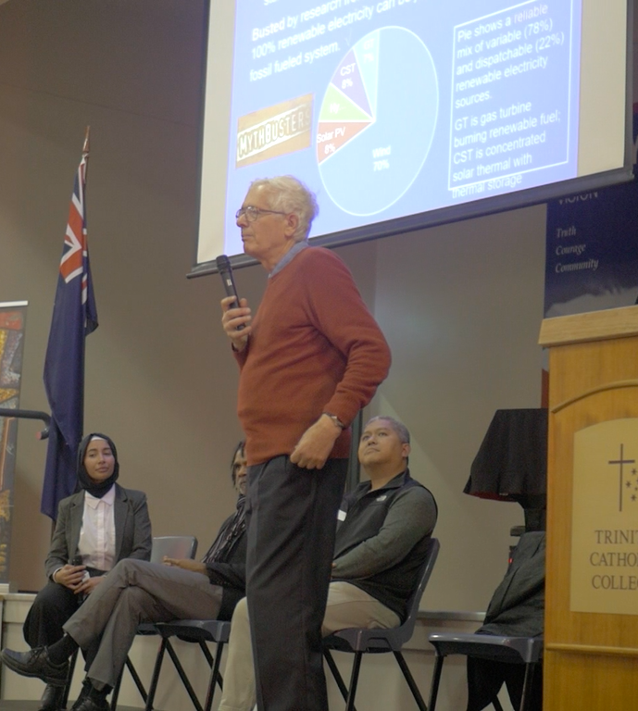
Indigenous Activist Bruce Shillingsworth
Prof. Mark Diesendorff

Slide 19
THE IMPACT

Slide 20
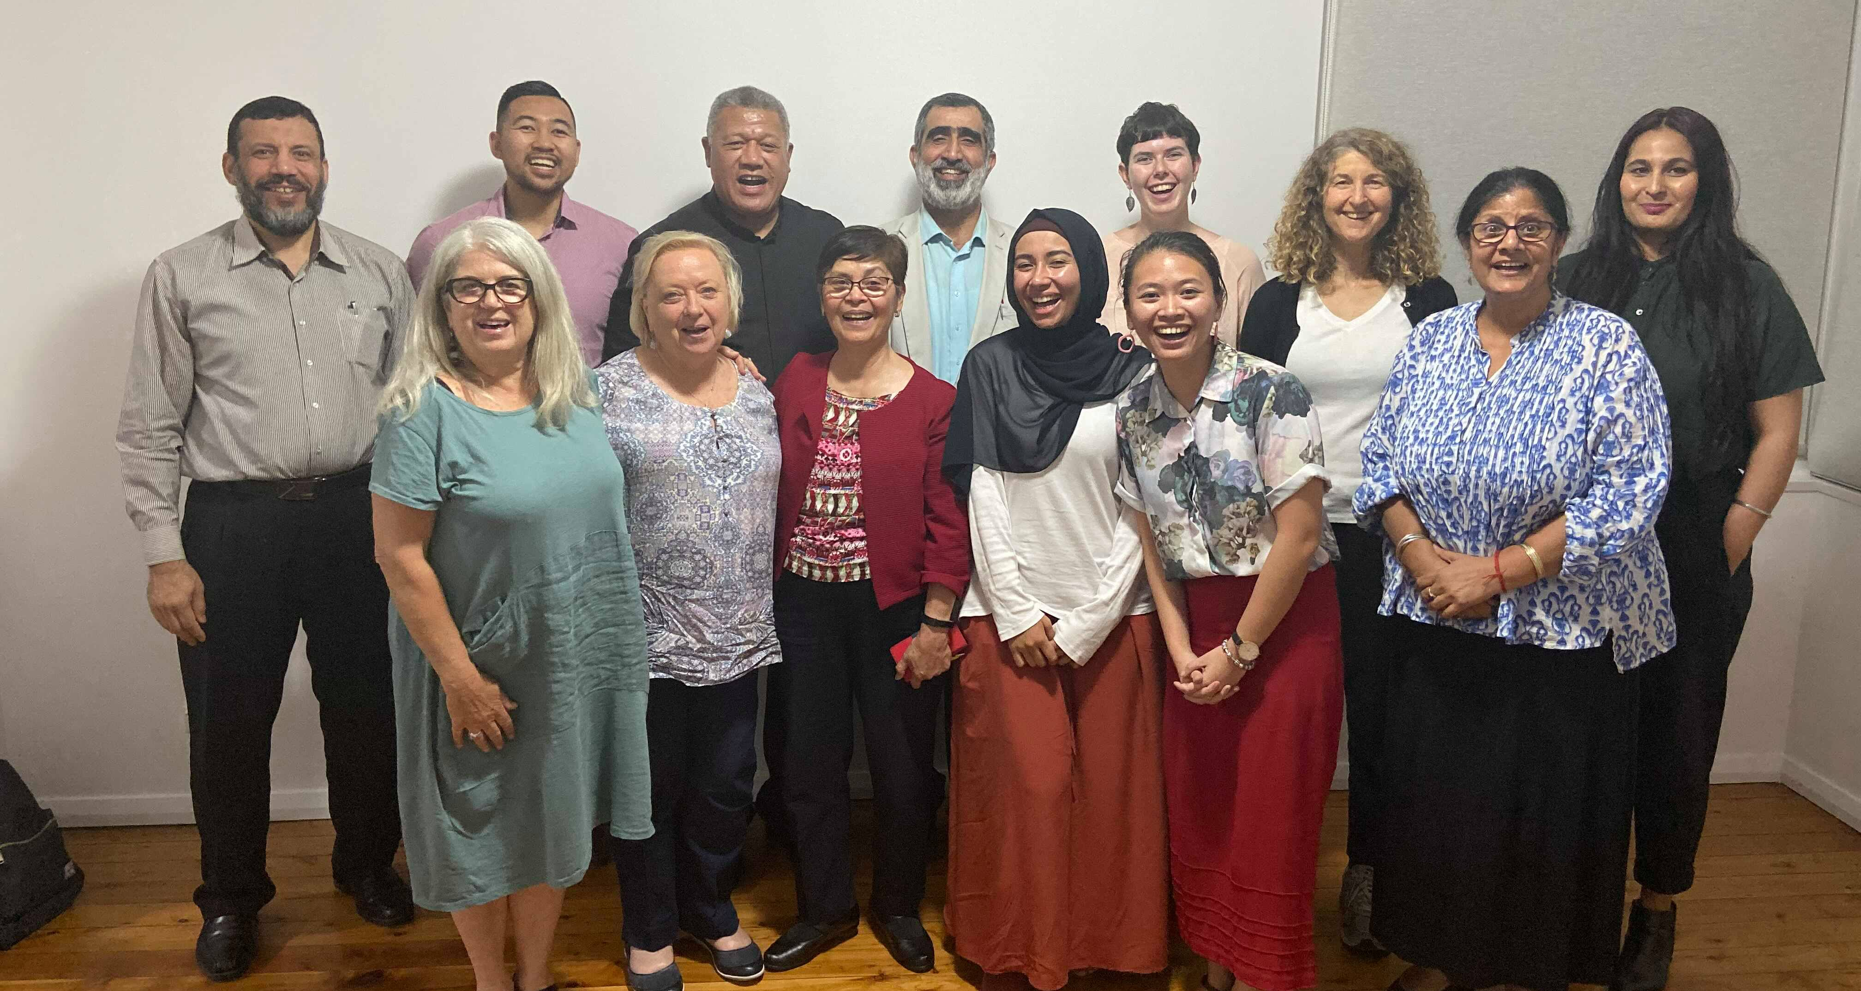
INDIVIDUAL LEADERSHIP DEVELOPMENT

Slide 21
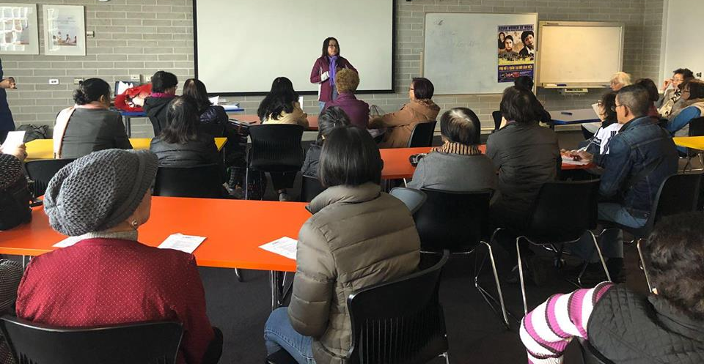
BUILDING COMMUNITY CAPACITY FOR ADVOCACY

Slide 22
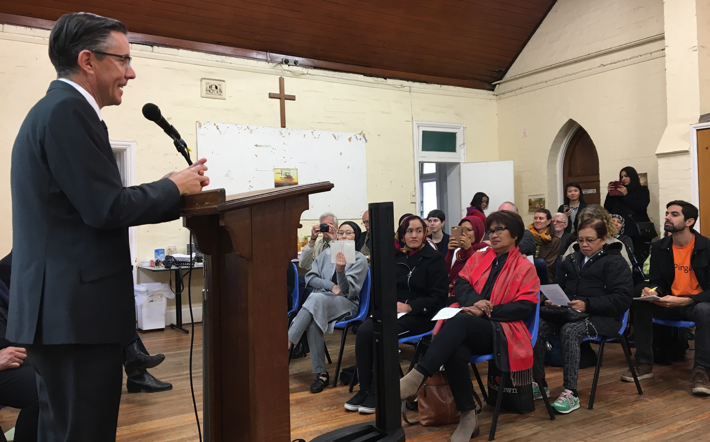
SHIFTING THE POLITICAL LANDSCAPE
Federal Opposition Minister for Energy Mark Butler promised to establish a
Community Energy Hub in Western Sydney.

Slide 23
WHAT WE’VE LEARNT ABOUT OUR COMMUNITIES

Slide 24
REBUILDING OUR TRUST IN THE ENERGY SYSTEM MEANS
BUILDING RELATIONSHIPS OF TRUST
Federal Opposition Minister for Energy Mark Butler promised to establish a
Community Energy Hub in Western Sydney.

Slide 25
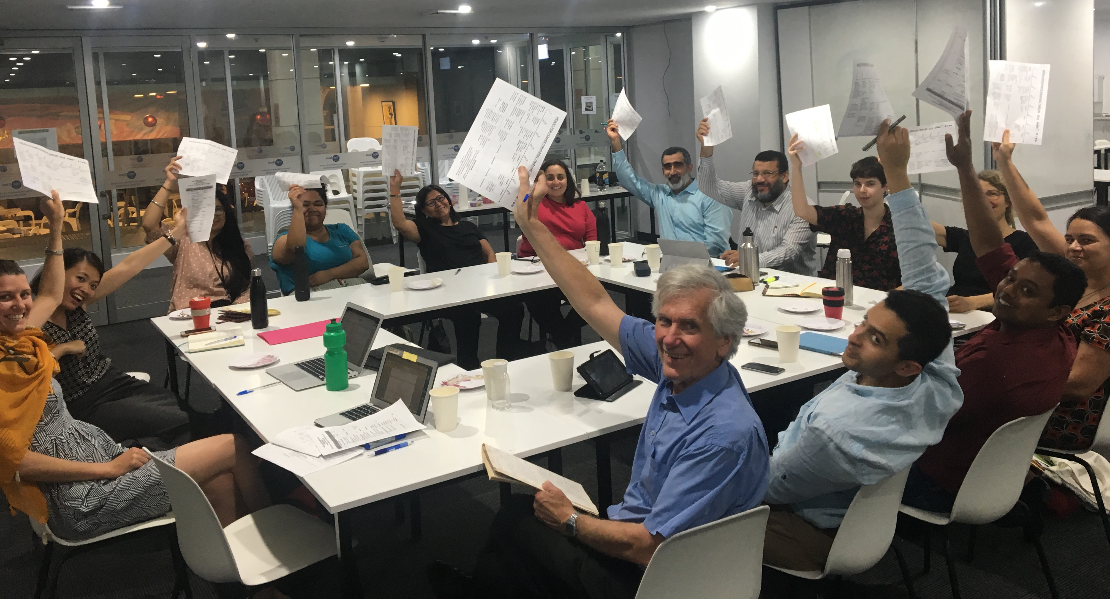
THIS MEANS OUR WORK IS LONG-TERM AND IT MUST INCLUDE COMMUNITY LEADERS IN THE PROCESS
Federal Opposition Minister for Energy Mark Butler promised to establish a
Community Energy Hub in Western Sydney.

Slide 26
VOICES FOR POWER
Organising migrant and religious communities to find solutions for AFFORDABLE & RENEWABLE ENERGY!
18th November 2019 | EWON Office
Michal Levy & VFP Leaders Delegation

