Slide 1
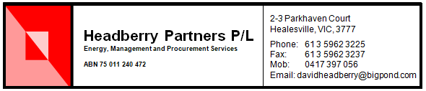
The electricity distribution network reset process
BSL and the Victorian EDPR 2020
Meeting 17 June 2019

Slide 2
Why get involved in a network reset
The cost of electricity delivered to an end user comprises three main elements
  The cost of the substations, steel lattice towers, poles and wires (~40% of the total for a home)
  The wholesale price of electricity (~40%)
  Environmental, retail margins and price risk management (~20%)
Wholesale and retail costs are set by competition and intervention in these is by rule changes and government action
The network charges are set by regulation and this allows end users to get involved in the detail of the costs.

Slide 3
What this forum explains
The process of a revenue reset for an electricity distribution network
How is the revenue each DB seeks built up
What are the drivers for network prices changing
What are the main cost elements in the revenue
What are the aspects that drive each cost element
How is the revenue converted to prices
Consumer engagement undertaken so far and its impact
Throughout this presentation I have used the draft proposal by Ausnet to provide an actual example of the costs involved
There is a 2 page summary of the core elements of the draft proposals from the five networks which Emma has

Slide 4
The process
Every 5 years each electricity distribution network proposes its costs for the next 5 years
Prior to a network proposing a new revenue, the AER identifies how it will manage the process and what the parameters will be for the reset, including the form of control (price or revenue cap) and other aspects including the classification of services (standard control, alternative control services), incentive schemes, approach to depreciation, etc). This work was done last year
The AER reviews the proposals made by each network and publishes an Issues Paper identifying its view of the salient issues and then has a public forum to discuss the proposals
The AER seeks stakeholder views of the proposals including the issues in the Issues Paper
The AER receives responses, releases a draft decision and has a public forum to discuss aspects of the draft decision
The networks revise their proposals and the AER receives responses to its draft decision and the revised proposals
The AER releases a final decision
This reset process takes some 15-18 months
This reset will be deferred by ~6 months to start July 2021

Slide 5
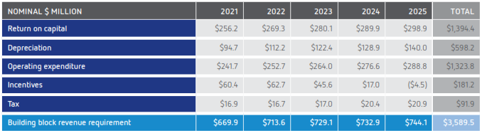
Building the revenue

Slide 6
Return on assets
In Victoria, the return on assets (RoA) is about 40% of the revenue
It is made up by multiplying the nominal value of the assets (regulatory asset base - RAB) by the “real” weighted average cost of capital – WACC
The WACC is fixed
Because the networks get other revenue (eg from incentive payments, use of assets by others, using less opex/capex, lower cost of debt), as a guide over the FY14 – FY17 period all 13 distribution networks in the NEM received a higher RoA than the WACC by some 100 bp of which 40 bp came from incentives
The starting RAB in each year is the ending RAB from the previous year + inflation - depreciation + new capex

Slide 7
Weighted average cost of capital (WACC) set by the AER
WACC = 0.4*cost of equity + 0.6*cost of debt
The cost of debt is recalculated each year so this means the WACC changes each year
Cost of debt is the trailing average of the 10 year corporate bond rate.
The cost of equity is fixed for the regulatory period
The cost of equity = RFR + MRP*βe
RFR = 10 year bond rate
MRP = market risk premium
βe = equity beta which is the risk factor

Slide 8
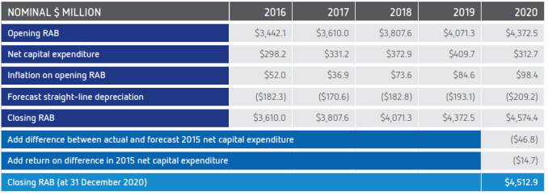
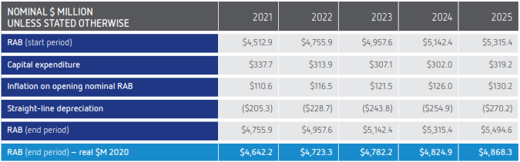
The RAB is brought up to date and then forecast for the next period

Slide 9
What drives the RAB
Inflation is exogenous
Depreciation is based on retirement schedules noting there is some difference between the DBs
So capex is the main driver of the RAB
  Augmentation to meet growth (peak demand and population)
  Replacement
  New connections
  IT
  Safety

Slide 10
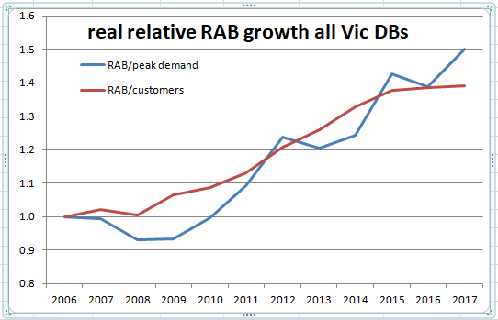
The RAB has grown over the past decade …

Slide 11
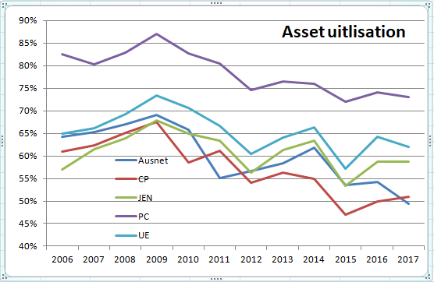
… but utilisation has fallen

Slide 12
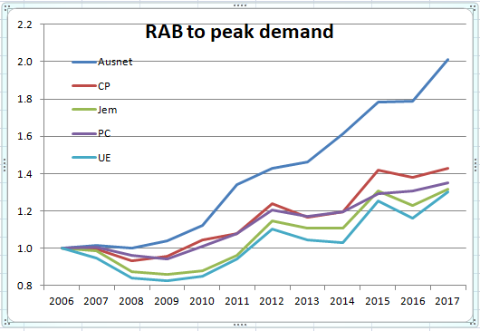
The RAB has grown over the past decade (2)

Slide 13
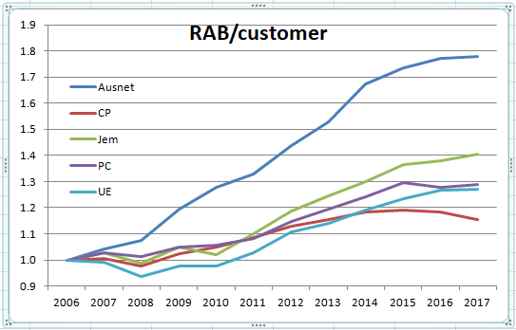
The RAB has grown over the past decade (3)

Slide 14
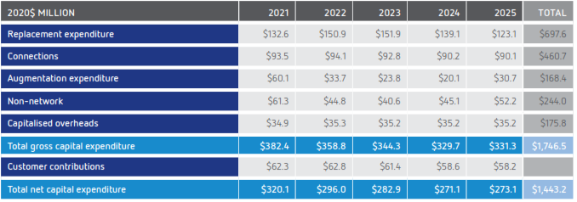
Capex

Slide 15
What the main elements of capex
Historically, capex was mainly augmentation expenditure to meet growth (augex)
As consumption has fallen and peak demand flat lined, augex has fallen considerably but we see the main cost increases are now in replacement capex (repex) and IT
In bushfire areas we have also seen capex to limit fire starts (REFCL program)

Slide 16
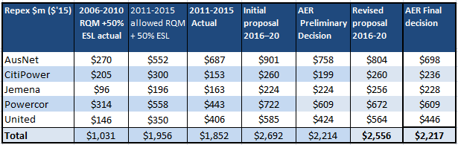
This is data from the last reset on repex growth

Slide 17
IT capex
The other increase in capex we have seen is in IT
Not only is the cost of IT increasing but it is depreciated over a short 5 year period
The aspect of concern is that effectively consumers pay the cost of the IT capex but they are seeing little value from the cost

Slide 18
Regulatory Depreciation

Slide 19
Regulatory Depreciation
Regulatory depreciation allowance has two elements
  Inflation of the asset base
  Straight line depreciation of the assets based on a schedule developed by the network
The main issue with the asset depreciation schedules is that there is no consistency between the different networks with some networks depreciating the same assets faster than other networks. For example UE depreciates its system assets over 36 years but Powercor does this over 51 years
The impact of this is that UE revenue in each year is higher than it would be if it used Powercor depreciation

Slide 20
Opex

Slide 21
Opex
Opex is about 37% of the total revenue
The process for setting the opex is to use the actual opex seen in year 4 of the regulatory period and use this as a base.
To the base we add:
  Price growth (inflation, labour costs)
  Output growth
  Step changes
  Adjustments for service classification, self insurance, GSL payments
Opex is benchmarked for productivity (moderated against peak demand, line length and customer numbers) to assess how far each network is from the efficient frontier

Slide 22
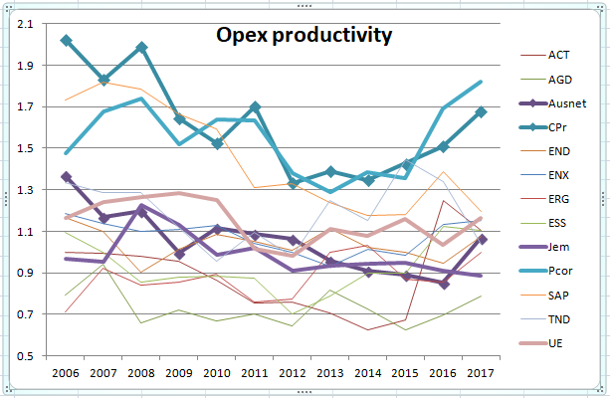
Opex productivity

Slide 23
Opex productivity
PC and CP would appear to be the most productive of the networks
UE, Jem and Ausnet are very much in the “ruck” and not near the efficient frontier
So the issue for consumers is to get UE, Jem, and Ausnet opex productivity similar to that achieved by CP and PC

Slide 24
Incentives

Slide 25
Incentives
Incentive on opex – EBSS
Incentive on capex – CESS
Incentive on reliability – STPIS
Incentive on demand management – DMIS
Most networks get an incentive payment which on average over FY14 – FY17 added another 40 bp to the actual RoA
This raises the question as to whether the incentive targets are too easy and whether the incentive programs are fit for purpose

Slide 26
Tax

Slide 27
Tax
The revenue build up is delivered as a post tax allowance
This requires the AER to provide an allowance for tax that the network will be liable for, as the allowance for profitability is an after tax allowance
A review of past outcomes indicates that government owned networks pay more tax than the AER allowed but privately owned networks paid less tax than that allowed.
The AER has carried out a detailed review of the way the tax allowance is crafted and has made some minor adjustments
As part of its recent settings for the WACC, the AER also determined a key input parameter (gamma) to the tax allowance calculation

Slide 28
Conversion of revenue to price
Networks are working together to have a common view on tariff structure
Tariffs are based on three elements
  A fixed element
  Demand
  Consumption
Customers are basically divided into two groups – larger users pay based on a demand tariff but smaller user (mostly small business and residential) pay based on consumption
Higher voltage customers use less of the network and their tariffs have lower unit rates
As most of the cost for providing service is from the peak demand each user has on the network there is a push to move all customers onto a demand based tariff. This would probably be more equitable
Roof top PV not paying to export biases pricing against those without rooftop PV
Cost reflectivity implies that the fixed element should be low
The tariff should be structured to provide a signal to use less at critical times as this would be economically efficient

Slide 29
Reliability
There are three basic measures for reliability
  Time off supply (SAIDI)
  Frequency of supply loss (SAIFI)
  Unplanned unserved energy
Most are trending downward
A few are essentially flat
Incentives are paid based on SAIDI and SAIFI through the service target performance incentive scheme (STPIS)
A consistent question from networks is to ask what lower reliability is acceptable and to offer a small saving for this lower reliability, but consumers are of the view that we could reduce costs and have little impact on reliability

Slide 30
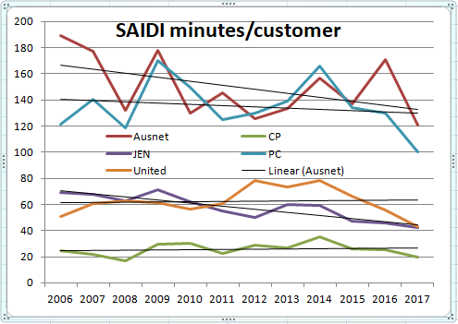
Reliability - SAIDI

Slide 31
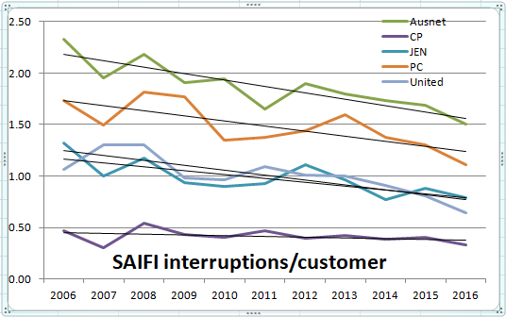
Reliability - SAIFI

Slide 32
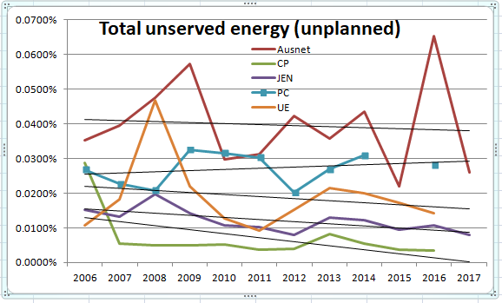
Reliability – USE (unplanned)

Slide 33
Consumer engagement (1)
Consumer engagement is where the networks seek end user input about the networks and its cost, and what the network delivers to consumers.
We know that delivered prices are too high from international comparisons and power is available mostly when we want it. But networks costs are only ~40% of the delivered price
Consumer concerns are primarily price and reliability but also include pricing structures, impact of rooftop solar PV, bushfire starts, demand management opportunities, etc
Consumers know about price and reliability but have limited skills to convert this as a trade off or to convert this to a reset and challenge the assertions of the networks.

Slide 34
Consumer engagement (2)
For EDPR 05 and EDPR 10 there was little formalised consumer engagement and what there was ,was limited to the regulator seeking input from a relatively few consumer advocates
For EDPR 15 there was more active CE by the networks and the AER had the Consumer Challenge Panel
Network CE for EDPR 15 was more consumer focused but was in its infancy, but CE for EDPR 2020 was more extensive
All the DBs have a consumer advisory group, have dialogue with consumer advocates, do focus group sessions, regional meetings, surveys, forums, workshops, website, etc
As well, Ausnet with AER and ECA has introduced a new approach where a five member panel (the Customer Forum – CF) is to negotiate with the network about certain costs to go in the proposal. The CF receives funding to carry out detailed consumer surveys and receives detailed input from Ausnet and the AER

Slide 35
The key issues and areas to focus on in the reset
Prices are too high and impose considerable harm to those on low incomes
Price v Reliability is a trade off
The RAB is too high
Why should users pay for oversized assets (ie low utilisation)
Capex is a major driver of costs and the incentive program drives less capex than allowed but consumers see little benefit
Low productivity networks are not being driven to the efficient frontier of opex
Reliability is improving but there are places where reliability is less than in other areas
How do we treat the incentive schemes as they seem to deliver a consistent bonus
Do we seek to reform pricing structures (eg to a demand based tariff)
A major concern is that the networks have the knowledge to provide advice as to the “best” way to address consumer concerns raised through consumer engagement

