Slide 1

Safeguarding consumer outcomes
The Behind-the-Meter Code of Conduct and emerging energy services
Dean Lombard
Senior Energy Analyst
Notes:
Renew, formerly the Alternative Tech Assoc, is a member organisation that helps people live sustainably in their communities. We publish magazines and books, give energy efficiency and solar/battery/appliance advice, run community events, and do research and advocacy.

Slide 2
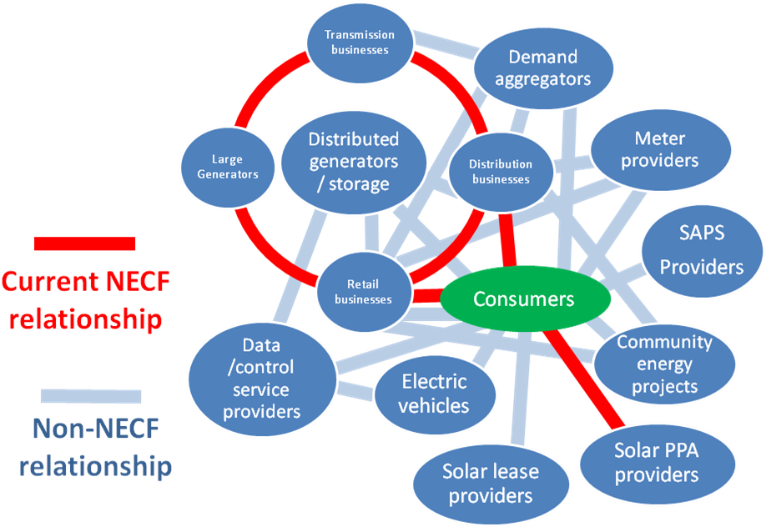
The problem
Energy consumer protections are predicated on sales of energy in the NEM. Transactions outside this are not captured by the National Energy Consumer Framework (NECF).
VPPs go here
Notes:
We’ve had a long interest in consumer protections in emerging energy markets. This diagram is from a report we published in 2016. (Describe what it shows)

Slide 3
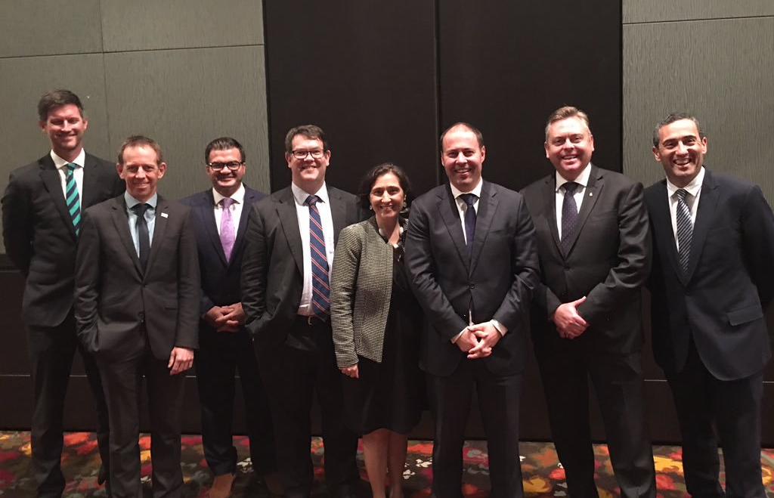
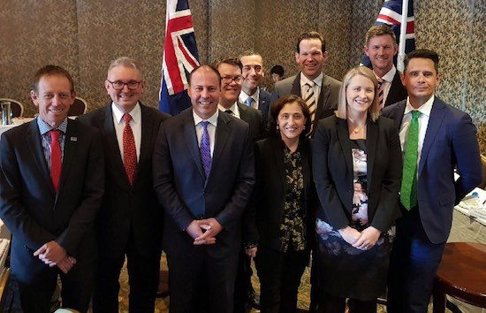








More regulation?!?
Redefine the scope of NECF?!?
The solution?
Caveat emptor?
2016 COAG Energy Council consultation on consumer protections for behind-the-meter products and services.
²⁰¹⁷
A voluntary industry code of conduct!
Notes:
Consultation in 2016, options of do nothing, regulate, redefine scope of NEM and NECF; decision in 2017 for voluntary industry code of conduct.
Request to industry bodies and ECA to develop; ECA brought in consumer orgs.

Slide 4
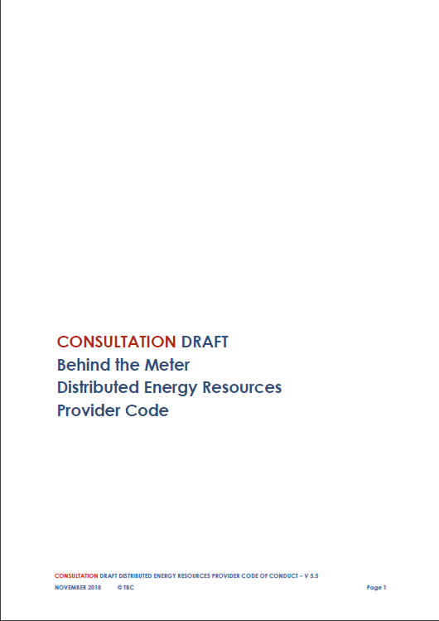

The BTM Code
Building on the CEC Code, but broader in scope and technology-neutral.
Expected to go live by the beginning of 2020.
Initial draft
General consultation
Technical consultation
Final draft
ACCC review
Final version
ACCC authorisation
Notes:
CEC Solar Retailer code as a starting point, but need to expand scope, future-proof, and strengthen some protections.
Code development is well underway, with an expectation that it will go live late 2019 or early 2020
Governance structure recently finalised, a Council of industry and consumer reps with an independent chair, which contracts with another body to administer the code and take legal and financial responsibility.
BTM is a terrible name. We need another. Any suggestions?
Clarify: retail code, not installer code. Retail activity and customer relationship, not safety and equipment (though it will refer to the appropriate installer codes, standards, etc.)

Slide 5
The customer journey
Marketing and presale
Purchase
Installation and activation
Operation and maintenance
End of life
Everything prior
to the customer expressing interest
Provider has
no specific knowledge of
the customer
Everything between customer expressing interest and completion of the sale
Provider has specific knowledge of
the customer
Installation of hardware
Connection to grid
Commencement
of the service relationship
Product or service is operational
Product or service is no longer operational
At each stage in the customer journey there are principles that will underpin good customer outcomes.
Notes:
The code is based around the customer journey, which starts from seeing advertisements or product information or being cold-called, and ends with the product or service no longer being used.
Code provisions cover a range of issues and areas such as

Slide 6
Code principles
Marketing practices
Dispute resolution
Explicit informed consent
Fit-for-purpose
Finance
Warranties
Privacy and data collection
Compliance and enforcement
The BTM Code aims to fulfil two roles:
Clarify the application of Australian Consumer Law
Provide additional protections where necessary
Notes:
The code has principles to promote good consumer outcomes in all these areas
Where possible, the code should make clearer the application of ACL to this sector (Example: product must be fit for purpose)
Where necessary, additional protections should be provided that are specific to energy products and services. (This is partly in recognition that for many people, the reason for entering this market is not for the products or services per se, but for financial benefit arising from investment in the product or service.)
ALSO e.g. requiring approved equipment from lists such as CEC’s, specific training for installers, etc.
EXPLAIN fit-for-purpose if less than halfway through time

Slide 7
From principles to requirements
PRINCIPLE: representations of the value of a product or service must use reasonable assumptions and consider site-specific factors
Solar panels
Annual generation estimate considering:
  location
  shading
  orientation
  known DNSP restrictions
Bill savings and RoI based on:
  generation estimate
  actual or typical electricity tariff
  actual consumption patterns
  declining performance over time
Virtual Power Plant
Where paid per event, compare with BAU considering:
  approx. number of events
  clear info about payment
  impact on battery life & performance
Where paid via discount hardware, bill savings and RoI based on:
  typical electricity tariff
  actual consumption patterns
  impact on battery utilisation and health
Notes:
This is an example of how the code works. The code proper has principles to advance good consumer outcomes, which will apply differently to different products and services. This approach aids future-proofing – principles can be applied to products and services that we don’t even know about yet.
Once particular products and services are established, guidelines are developed to guide interpretation of the principles.

Slide 8
Some issues for VPP customers
The value proposition
How does the customer figure out if it’s a good deal?
Privacy and security
Data usage and rights
Finance (where applicable)
Impact of payment difficulties or defaults → use of licensed credit providers
Obligation to participate
Ability to override remote control?
How often and with what consequences?
Obligation to facilitate
Customer provision of internet access?
What if energy usage increases and battery is not sufficiently charged?
Adverse impacts
Impact of VPP operation on battery
  battery cycles → health → lifetime
  warranty conditions
Change in circumstances
What happens if house is sold?
Exit fees?
Notes:
These are some issues that were identified during the technical workshop a few weeks ago. Addressing these limits the potential for unexpected adverse outcomes.
ALSO DATA

Slide 9
Benefits
Risks
Ensure customer is considered
Sometimes customer perspective is overlooked in planning and delivering innovative tech programs
Minimise adverse outcomes
Social license can be compromised if there are poor customer outcomes
Stand out in the market
Accreditation differentiates businesses from those who are unaccredited
Consumer confidence
Good customer protections build consumer confidence
Compliance and enforcement
Poor compliance and enforcement undermines the value of a code of conduct
Coverage
Low coverage compromises consumer and industry outcomes:
  Too many unaccredited businesses behaving poorly entrenches poor consumer outcomes
  Low membership limits economies of scale that make membership affordable to small players
Notes:
The emerging energy products and services market is huge and growing and confusing for customers. Good consumer protections give consumers more certainty and thus more confidence to engage with the market. Think about the lack of consumer confidence in retail energy markets: can you imagine any consumer engaging with that market if they didn’t have to?
Many government solar programs already require participating businesses to be CEC-accredited. The BTM code will be appropriate to be used in this way in future programs

Slide 10
VIRTUOUS CIRCLE
The more businesses that are accredited:
the more accreditation is a market advantage
the cheaper accreditation fees will be
the more the code is a consumer benefit
Notes:
The emerging energy products and services market is huge and growing and confusing for customers. Good consumer protections give consumers more certainty and thus more confidence to engage with the market. Think about the lack of consumer confidence in retail energy markets: can you imagine any consumer engaging with that market if they didn’t have to?
Many government solar programs already require participating businesses to be CEC-accredited. The BTM code will be appropriate to be used in this way in future programs

Slide 11
Thank you
More information:
cleanenergycouncil.org.au/advocacy-initiatives/behind-the-meter-code
Dean Lombard
dean@renew.org.au
Renew’s participation in the BTM Code project was funded by Energy Consumers Australia (www.energyconsumersaustralia.com.au) as part of its grants process for consumer advocacy and research projects for the benefit of consumers of electricity and natural gas. The views expressed in this presentation do not necessarily reflect the views of Energy Consumers Australia.

