Slide 1
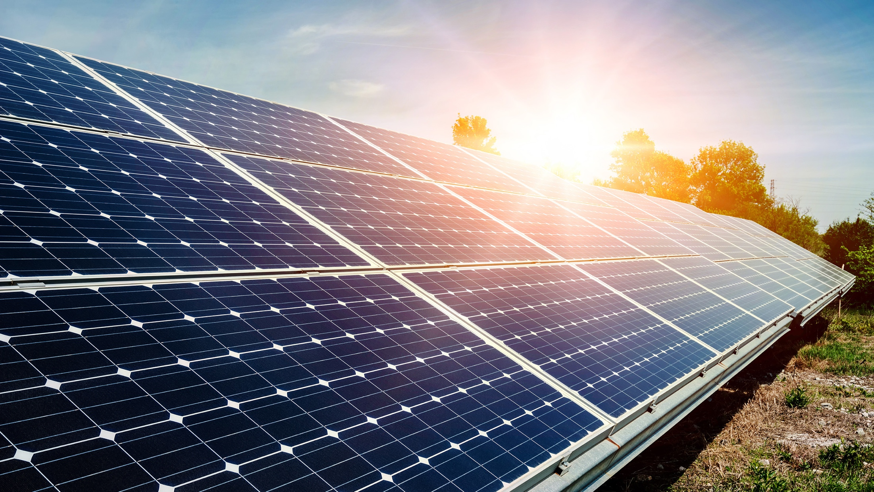
With great data comes great opportunity
Real examples and future possibilities of consumer energy data

Slide 2
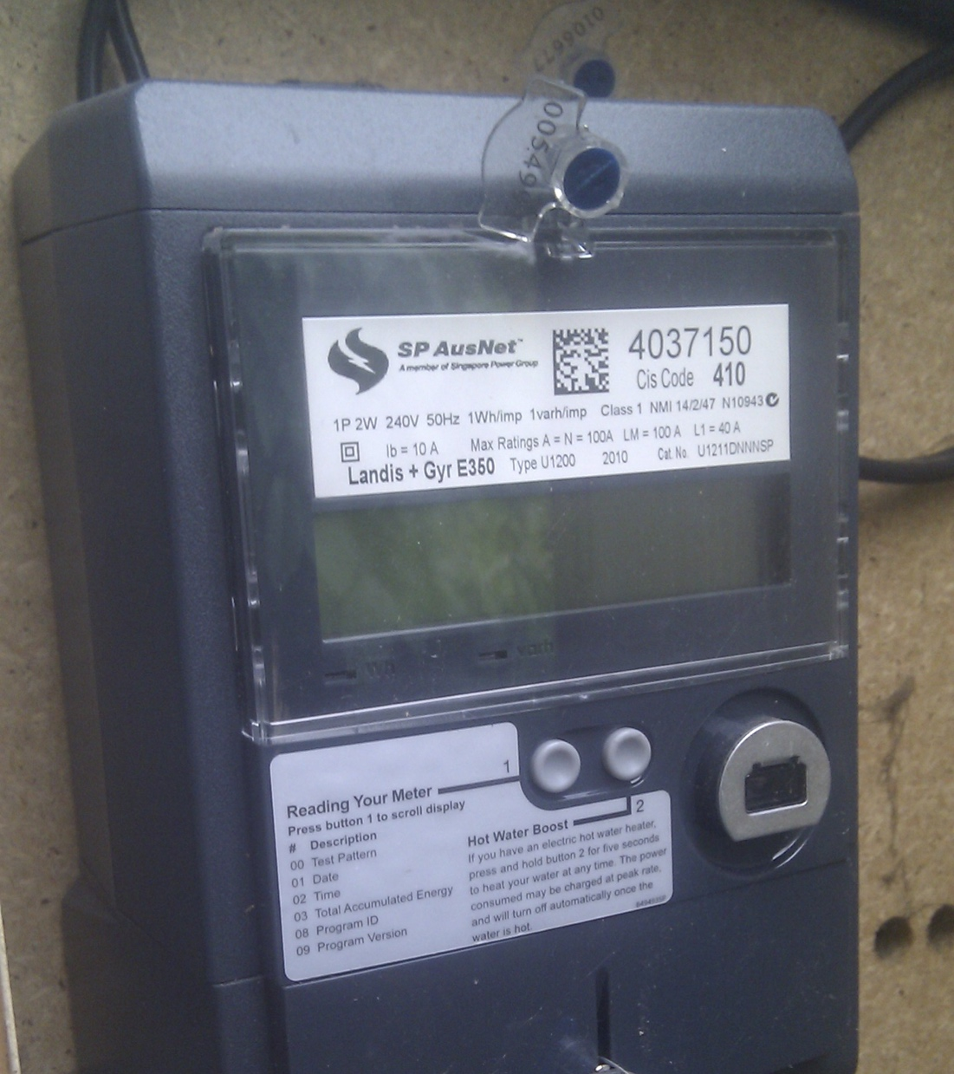
Smart meters
A great consumer benefit? Or a false promise that never delivered?
How is energy data being used right now to benefit energy consumers?
Notes:
Without some sort of data logger, energy data is quarterly aggregated usage. Smart meters are the most likely source of energy data gartering to become widespread.
Some of the commentary in Vic is that consumers haven’t had much benefit from smart meters. We disagree!

Slide 3
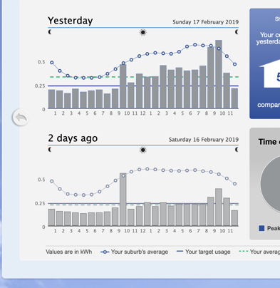
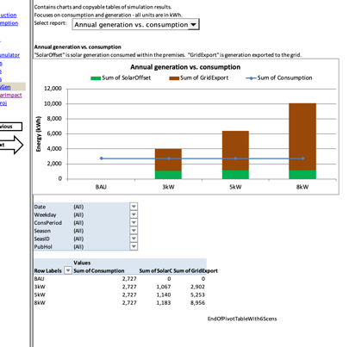
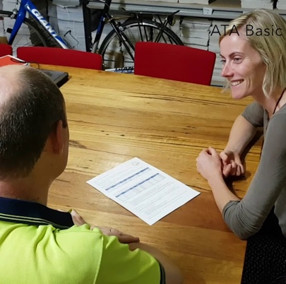
…………………………………
HISTORIC DATA
Understand usage patterns and make decisions about changes
Understand, choose, and compare…
…………………………………….
Energy offer comparisons or solar/battery system sizing based on actual usage
…………………………………
Third parties with authorisation to access customer data add significant value in most cases
Notes:
Use of historic data is probably the most concretely useful for consumers. As long as there is an awareness that future usage doesn’t necessarily follow past usage, historic data can help a whole lot of decision making

Slide 4
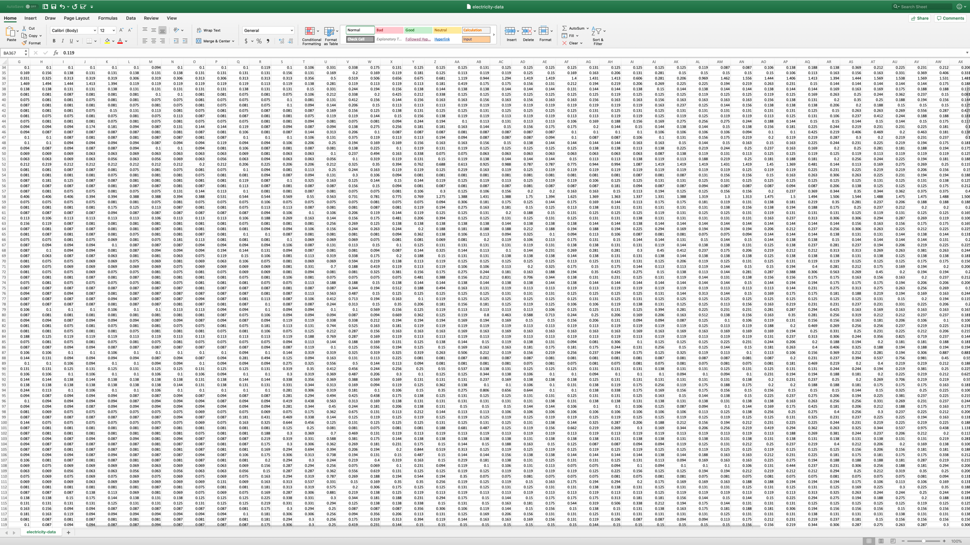
…………………………………
HISTORIC DATA
Understand usage patterns and make decisions about changes
Understand, choose, and compare…
…………………………………….
Energy offer comparisons or solar/battery system sizing based on actual usage.
…………………………………
Third parties with authorisation to access customer data add significant value in most cases

Slide 5
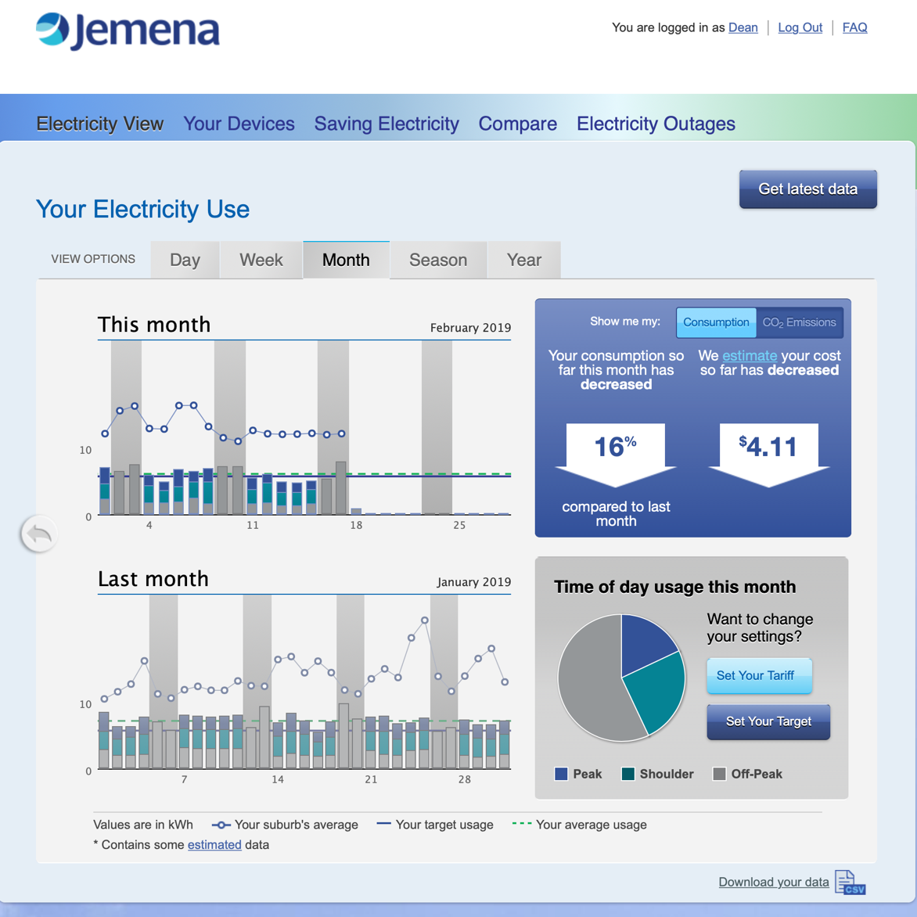
HISTORIC DATA
Understand, choose, and compare…

Slide 6
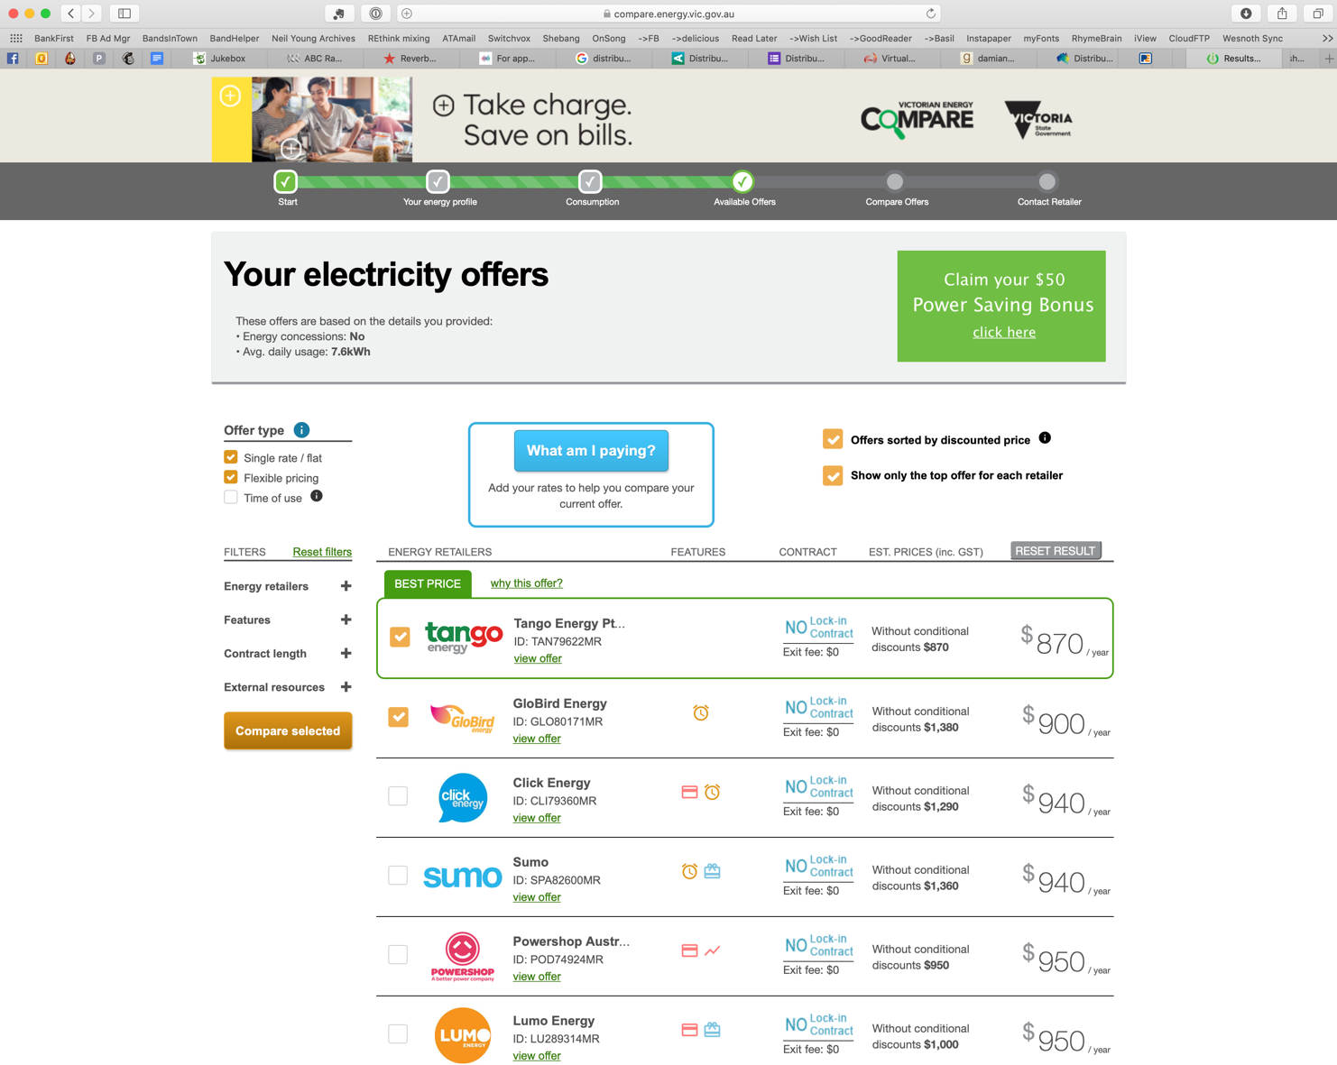
HISTORIC DATA
Understand, choose, and compare…

Slide 7
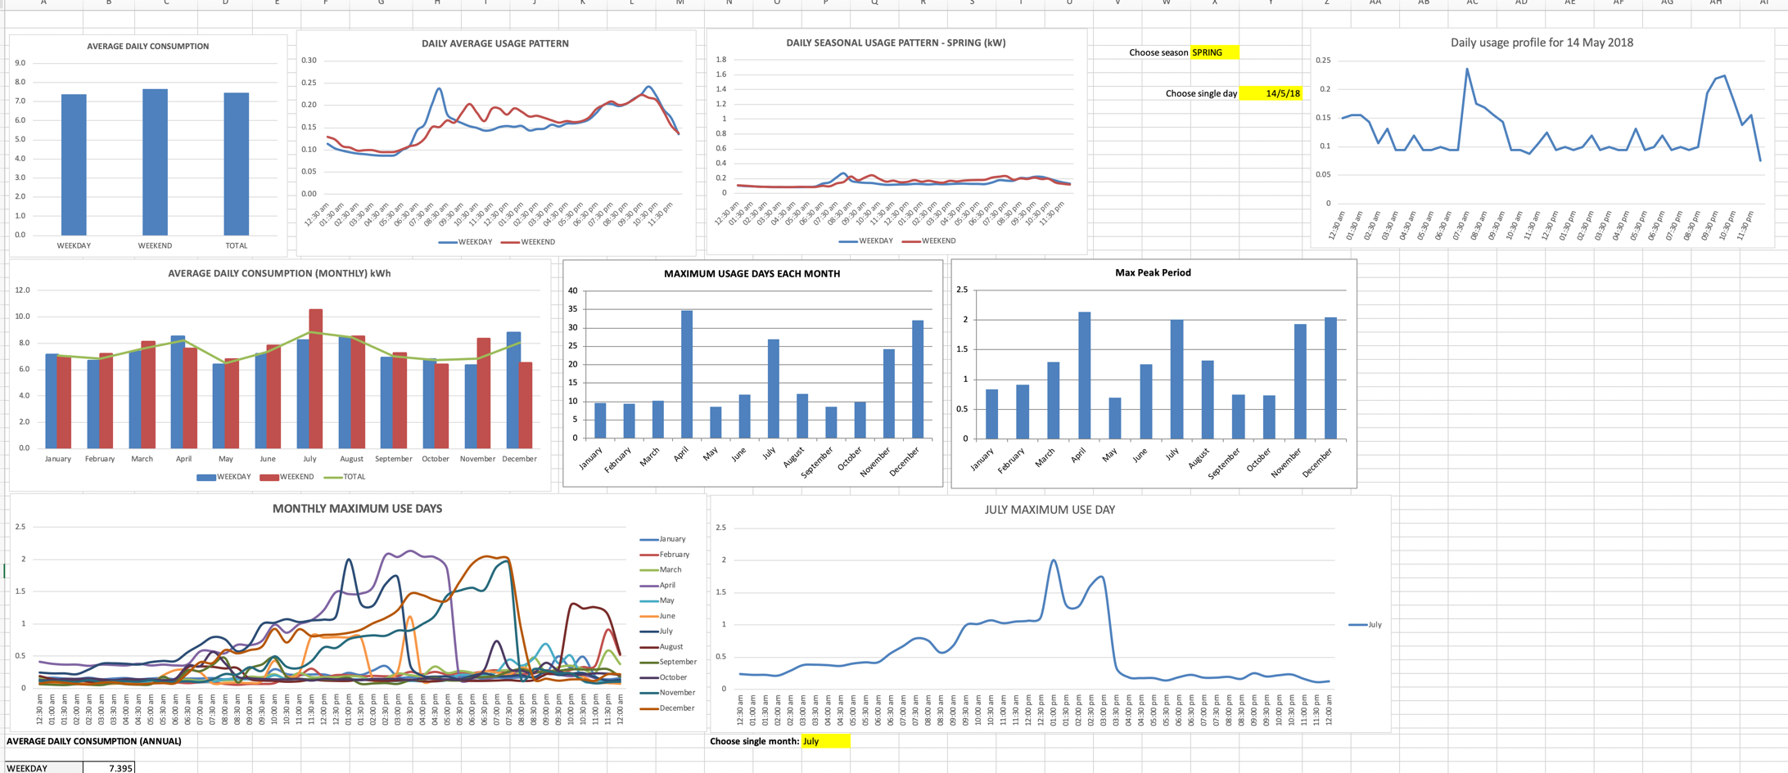
HISTORIC DATA
Understand, choose, and compare…

Slide 8
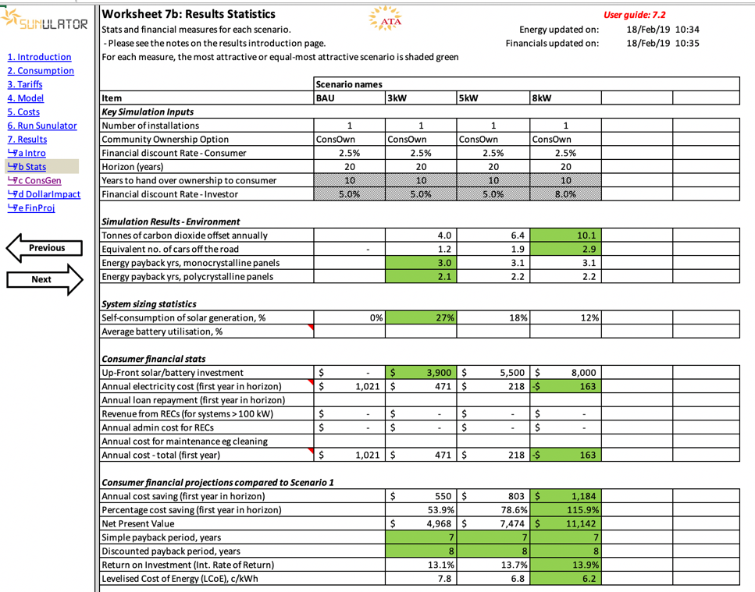
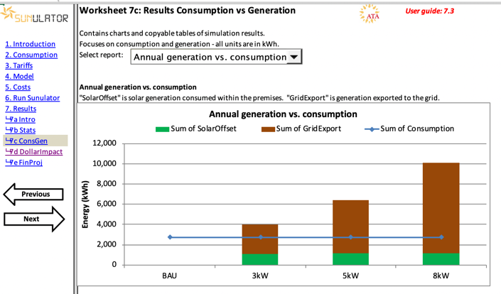
HISTORIC DATA
Understand, choose, and compare…

Slide 9
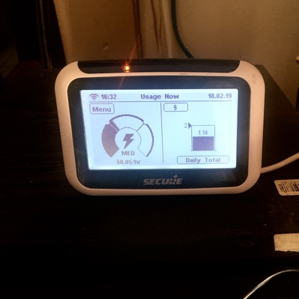
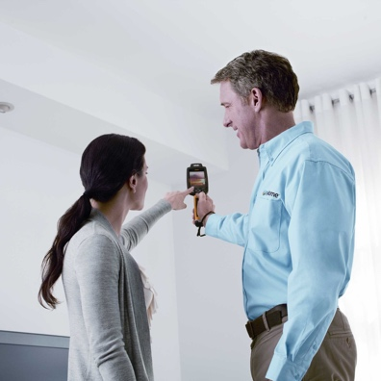
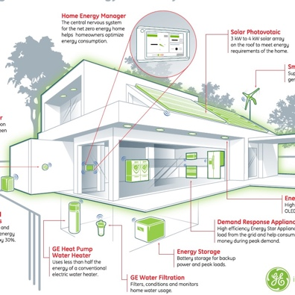
…………………………………
Help consumers understand their consumption in the moment and identify inefficient appliances and practices
REAL TIME DATA
React and respond…
…………………………………….
Enhance energy audits with demonstrations of appliance usage and consumption
…………………………………
Add value to demand response, load control, responsive energy management services
Notes:
Real-time data has limited but specific uses.
IHDs an untapped opportunity. Traffic light display great for anyone tyring to watch their usage or spot behaviours that lead to high unnecessary energy use
Auditors could enhance their advice with real-time data
remote control services can se real time data as an extra factor in decision making

Slide 10
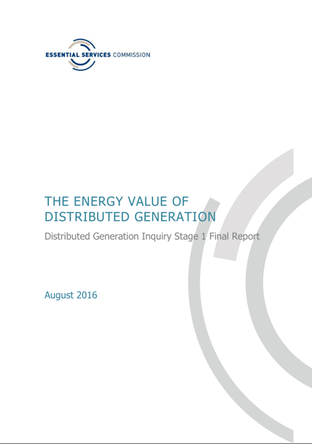
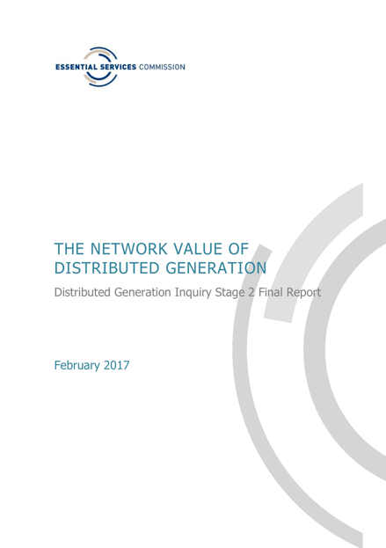
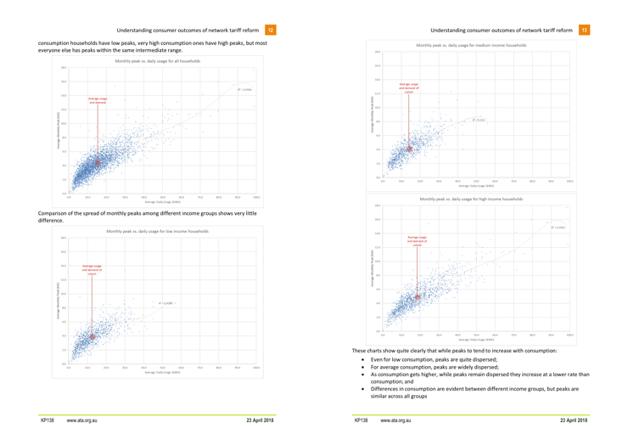
…………………………………
AGGREGATED DATA
Individual and aggregated
granular localised data can guide energy businesses’ and governments’ planning and decision-making
Plan and analyse…
…………………………………….
Deidentified rich energy datasets can help researchers and advocates understand the impact of tariffs, energy technology, concessions, etc.
Notes:
Aggregated data usage by trusted third parties for community benefit is hugely valuable. The right access regime and privacy protections are critical

Slide 11




Making it happen
Risks need to be managed and measures put in place to make it work for everyone
PRIVACY
& SECURITY
Privacy Act coverage
Informed consent
Security standards
ACCESS
Data standards
Interoperabiity
Access rights (incl. third party access)
COSTS
Centralisation?
Contestablility?
Regulatory oversight
CUSTOMER PROTECTIONS
Regulation?
Voluntary code?
Dispute resolution
Notes:
Access rights should include for community benefit uses of anonymised aggregated data
Contestability: LOL

Slide 12
Thanks
Dean Lombard
Senior Energy Analyst, Renew
dean@renew.org.au
Renew’s involvement in customer energy data policy development and advocacy is part of a project funded by Energy Consumers Australia (www.energyconsumersaustralia.com.au) as part of its grants process for consumer advocacy and research projects for the benefit of consumers of electricity and natural gas. The views expressed in this presentation do not necessarily reflect the views of Energy Consumers Australia.

