Slide 1
We recognise the traditional owners of the land we meet on: The Kaurna people.
Students from Kaurna Plains school, Elizabeth

Slide 3
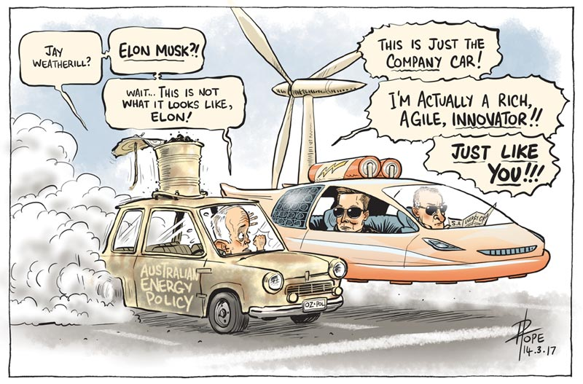

Slide 5
SAPN: Balancing Competing Objectives

Slide 6
Energy’s Tectonic Plates
Reliable
Sustainable
Affordable
We focus on where the plates collide

Slide 7
PV uptake

Slide 8
ACCC
Electricity
Wages
CPI

Slide 9
Electricity Price Changes, SA in red

Slide 10
ACCC – Achievable Savings

Slide 11
ACCC Prompted Observations
Prices still rising for SA consumers. Electricity bills still #1 presenting issue for Financial Counselling (and other) clients
SAPN not the main source of ACCC identifies savings, but still needs to understand customer pain
SAPN not expected to be the source of main electricity price reductions, but still expected to do the best that they can

Slide 12
Actual and forecast energy delivered
Lower demand than in the past, should be some benefits for consumers.

Slide 13
Capex

Slide 14
Connections
2015-20 is the first reg period using the NECF connection arrangements of Chapter 5A of the NER.
Does not appear that any review of performance to date.
SAPN has proposed a revised Customer Connection Policy (Attachment 16) and a capital expenditure program for connections of $213m net of customer contributions ($563m gross, Attachment 5).
Changes to the classification and process are proposed – See Issues Paper 8.4
Connections costs: proposal > current period > draft plan
But … no evidence of stakeholder engagement on connection issues

Slide 15
Opex

Slide 16
Opex, Proposed Step Changes

Slide 17
Opex
More work needed:
Productivity
Step Changes
IT

Slide 18
TAX
This is the hard one!
New AER Guideline, this is good
SAPN seems to have been impacted more than other db’s?
SAPN responses impact opex, capex, depreciation etc
More thinking and discussion needed before revised revenue proposal

Slide 19
SAPN Future Network Engagement – to December 2018
Need future, Future Network Engagement plan –
shared challenges, Shared Solutions

Slide 20
DMIA 2016/17. AER Data

Slide 21
Summary Response to SAPN Reg proposal
SAPN efforts to bring prices down appreciated, but can they do better still?
Seems to be room to move on:
Opex productivity,
IT,
non-network capex,
tax
maybe connections,
maybe tariffs

Slide 22
SA Leading the World, no roadmap - shared solutions

