Slide 1
Enabling consumer energy resources in our electricity grids Findings and recommendations so far from the CER Enablement Project

Slide 2
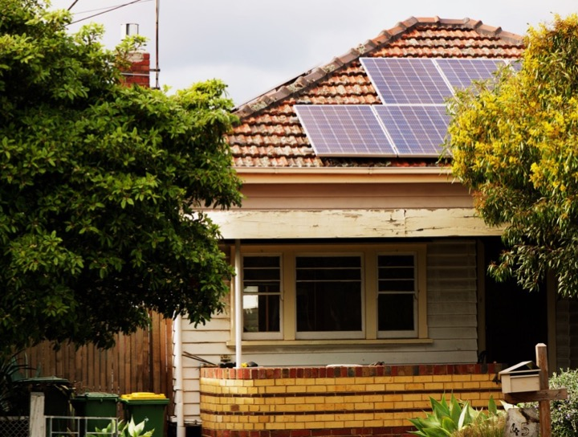
☺ or ☹ ?
Notes:
How do we let people invest as they wish in CER without causing problems in the grid

Slide 3
FIRST PROJECT (2019–20)
What are all the technical issues associated with excess solar exports?
+
What are all the techniques available to manage them? (and how much do they cost?)
=
What are the most cost-effective ways to enable more CER without stuffing up the grid?
Funded by Energy Consumers Australia Technical work by Energeia
Notes:
We consulted widely with industry, government, consumer stakeholders

Slide 4
FIRST PROJECT (2019–20)
Findings:
Tap changes and load control get us there for a while…
…but not everywhere, and not for so long
More sophisticated system-wide and forward-looking modelling is needed to map the whole suite of approaches – technical, policy, regulatory, and market – needed to reach a future where DER penetration is at the optimal level for maximum consumer benefit in a safe, secure and reliable grid.
Notes:
We consulted widely with industry, government, consumer stakeholders

Slide 5
Second project (2020–21)
A modelling and analysis project
Funded by Energy Consumers Australia
Technical work by Energeia
Peer review by CutlerMerz
Three stages
Iterative modelling to find the optimal future state
based on findings of the first project
Identifying what’s needed to attain that state
and what the barriers are
Prioritising future advocacy
which barriers need the most attention

Slide 6
The Consumer High DER scenario
An ideal scenario, not a forecast
By estimating the size of the prize without considering the associated barriers, it can be used to inform decision-making regarding the prioritisation of any policy, regulatory, industry and institutional reforms needed to [overcome these barriers and] achieve the identified optimal levels of [CER] investment.
It shows what’s possible
127 GW rooftop solar in 2050
Up from 20 GW today
136 GWh BTM battery storage
Up from 1.4 GWh today
Notes:
Remember, this is with 75% of dwellings with solar and most with batteries
The modelling shows that with the right enablement measures this is cost-effective

Slide 7
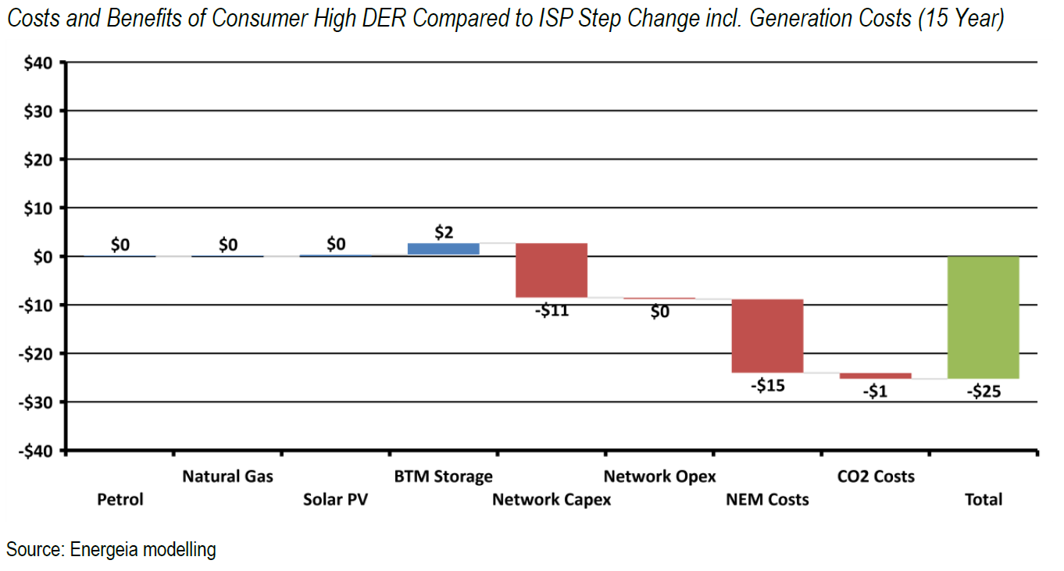
$25b net benefit by 2035
Compared to Step Change scenario from 2020 ISP
Notes:
Benefits are overstated c.f. 2021 Step Change but still significant
Petrol and gas are the same in both scenarios

Slide 8
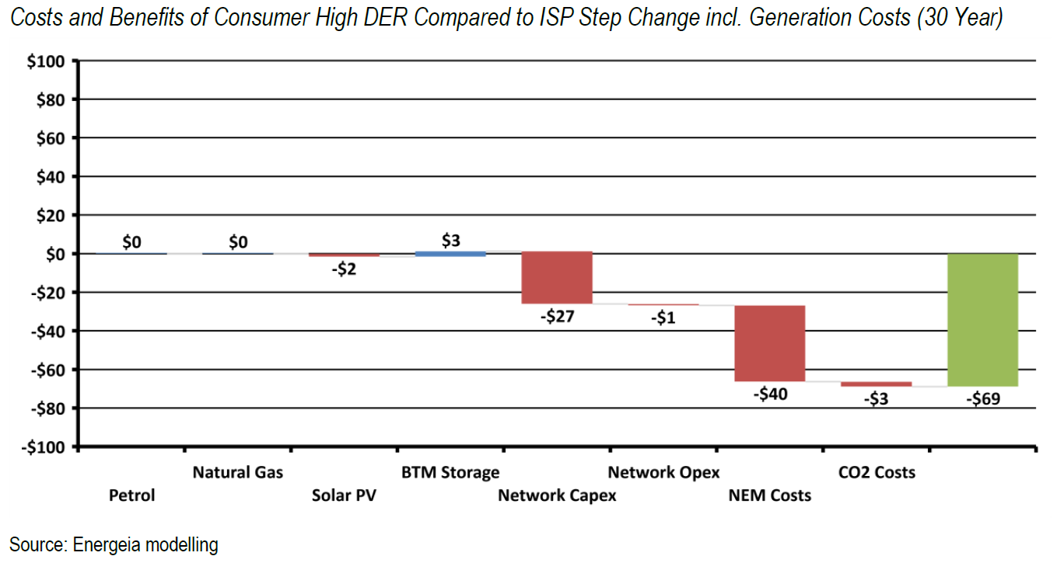
$69b net benefit by 2050
Compared to Step Change scenario from 2020 ISP
Notes:
Benefits are overstated c.f. 2021 Step Change but still significant
Petrol and gas are the same in both scenarios

Slide 9
What the future looks like
Optimal CER adoption rate is less than the current rate, but increases over time
Distribution and transmission capacity requirements reduced by 23%.
Significant curtailment of solar PV and wind occurs, but solar exports still valuable.
Spot prices increasingly negative when solar PV generation is high.
Orchestrated CER plays a major role in shifting load to minimize curtailment of solar exports.
Annual NEM consumption declines from 2036 as coal exits, reducing solar curtailment.
Enabling VPPs for reliability and security supports timely exit of aged generation.
Notes:
Basically: the system works

Slide 10
Overcoming the barriers
Levelling the playing field
Accurate network price signals nodal and dynamic price signals to properly value CER (import, export, LuoS tariffs
Fully recognizing the network value of CER right down to the LV level (expand the RIT-D?)
Enabling CER management and deployment
Holistic and transparent distribution planning in the LV and HV network to maximise opportunities for active CER to support network operations
CER management systems – standards, interoperability to maximise opportunities for orchestration balancing network and market services
Overhauling regulatory incentives
Delinking network investment from DNSP valuations – reforming incentive schemes, linking shareholder returns to network user outcomes
Notes:
More detail in the report

Slide 11
Next steps
Fine-tuning the recommendations
Further stakeholder engagement
Have we got it right? Have we missed anything?
Advocacy priorities
Where is targeted advocacy most needed?
What is already happening OK?
Future and parallel work?
Is there any area that needs more research, modelling, analysis, etc.?
What parallel work is needed to complement this CER enablement agenda (e.g. housing and appliance standards?)
Notes:
Basically: the system works

Slide 12
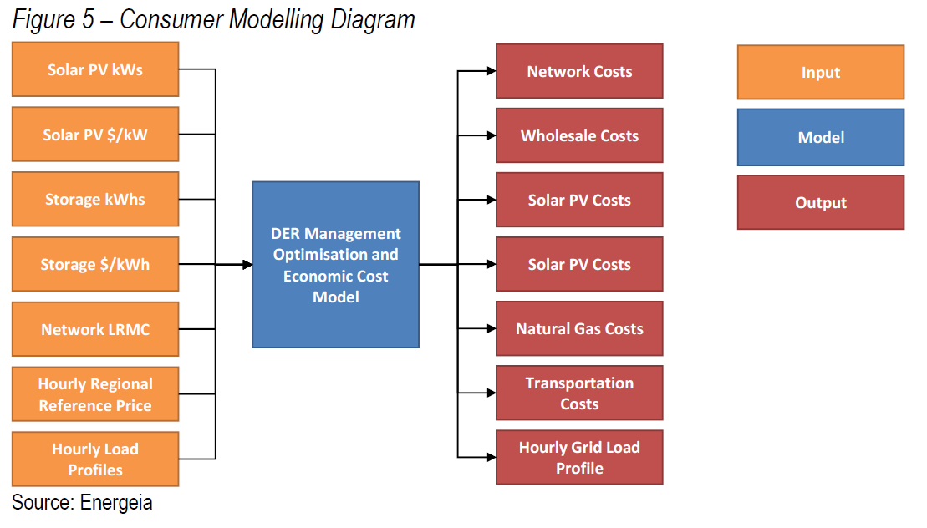
The consumer model
Notes:
Basically: the system works

Slide 13
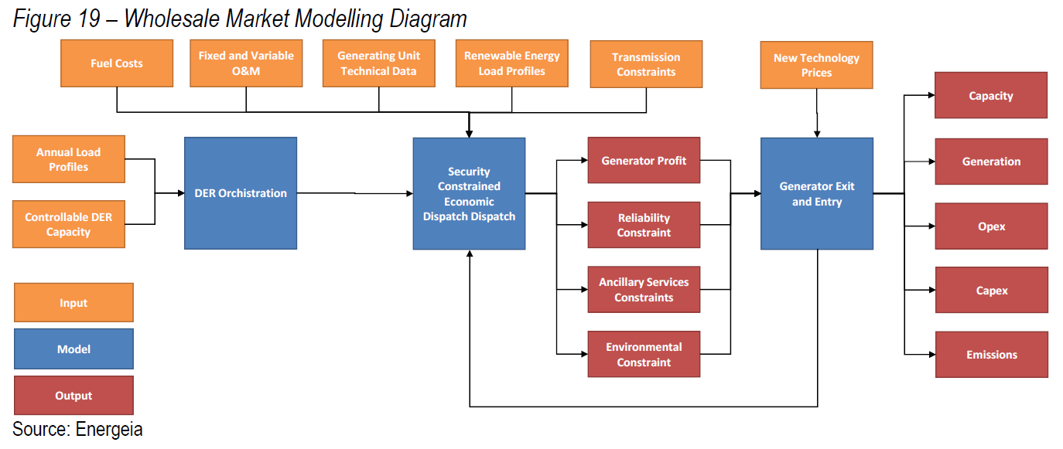
The wholesale market model
Notes:
Basically: the system works

Slide 14
Renew’s vision is to create a world in which communities thrive in a way that does not cost the earth.
Our strategic objectives are built on more than 38 years of knowledge on sustainable housing, networks in the building sector and expertise in market advocacy.
www.renew.org.au

